Slide 1
Culture: at the heart of the Québec identity

Slide 2
Culture is
in the DNA of Quebecers.

Slide 3
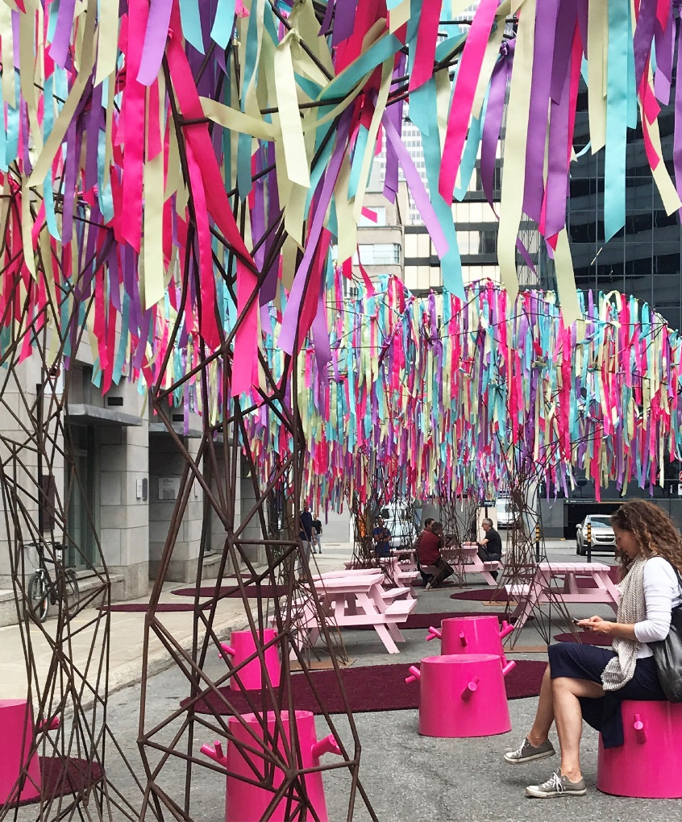
QUÉBEC: A BREEDING GROUND FOR CREATIVITY
We cultivate innovation and creativity throughout Québec!
Montréal, cultural metropolis, digital creativity hub with lively public spaces
Québec, world heritage city and focal point for literature
Regions brimming with artistic and cultural vitality
La Forêt urbaine © Tourisme Montréal / McCord Museum

Slide 4
QUEBECERS LOVE ATTENDING FESTIVALS… OFTEN!*
Québec is home to more than 400 cultural events and festivals, including many that are international in scope and world renowned.
Montréal international Jazz Festival
Festival d’été de Québec
Carrefour international de théâtre
Festival Montréal complètement cirque
Myriads of concerts and shows are presented virtually, in theatres or outdoors year round.
* Accessible cultural sites are subject to existing health rules.

Slide 5
Quebecers are proud of their culture.
Because it’s unique, bold and dynamic.

Slide 6
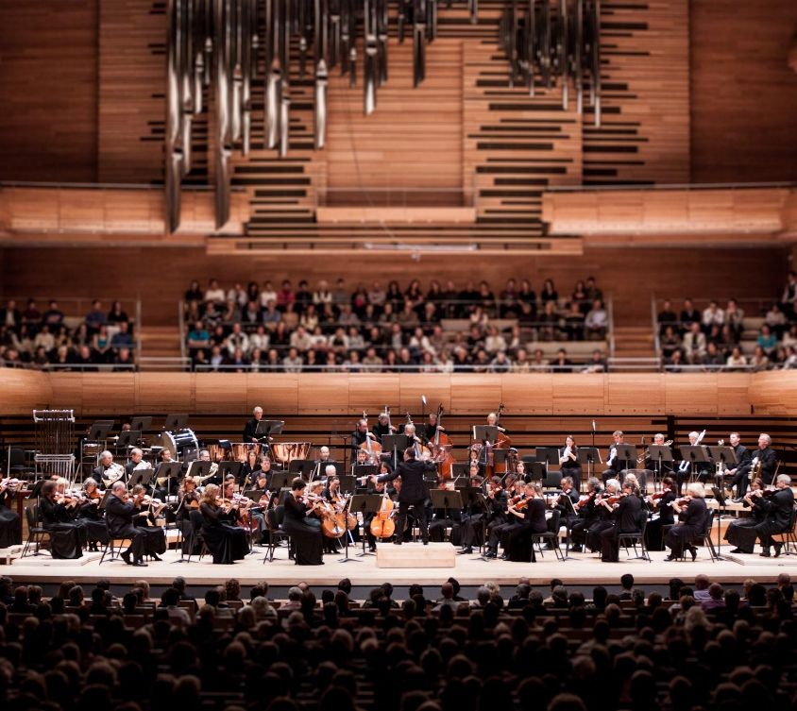
QUÉBEC: A TRUE INCUBATOR FOR MUSICAL TALENT
Québec boasts a multitude of musicians in all musical genres: from classical and electronic to folk, pop, rock and more!
Internationally acclaimed Québec artists…
Céline Dion
Leonard Cohen
Yannick Nézet-Séguin
… and a talented, ambitious up-and-coming generation of musicians
Les Louanges
Kaytranada
Charlotte Cardin
Orchestre symphonique de Montréal

Slide 7
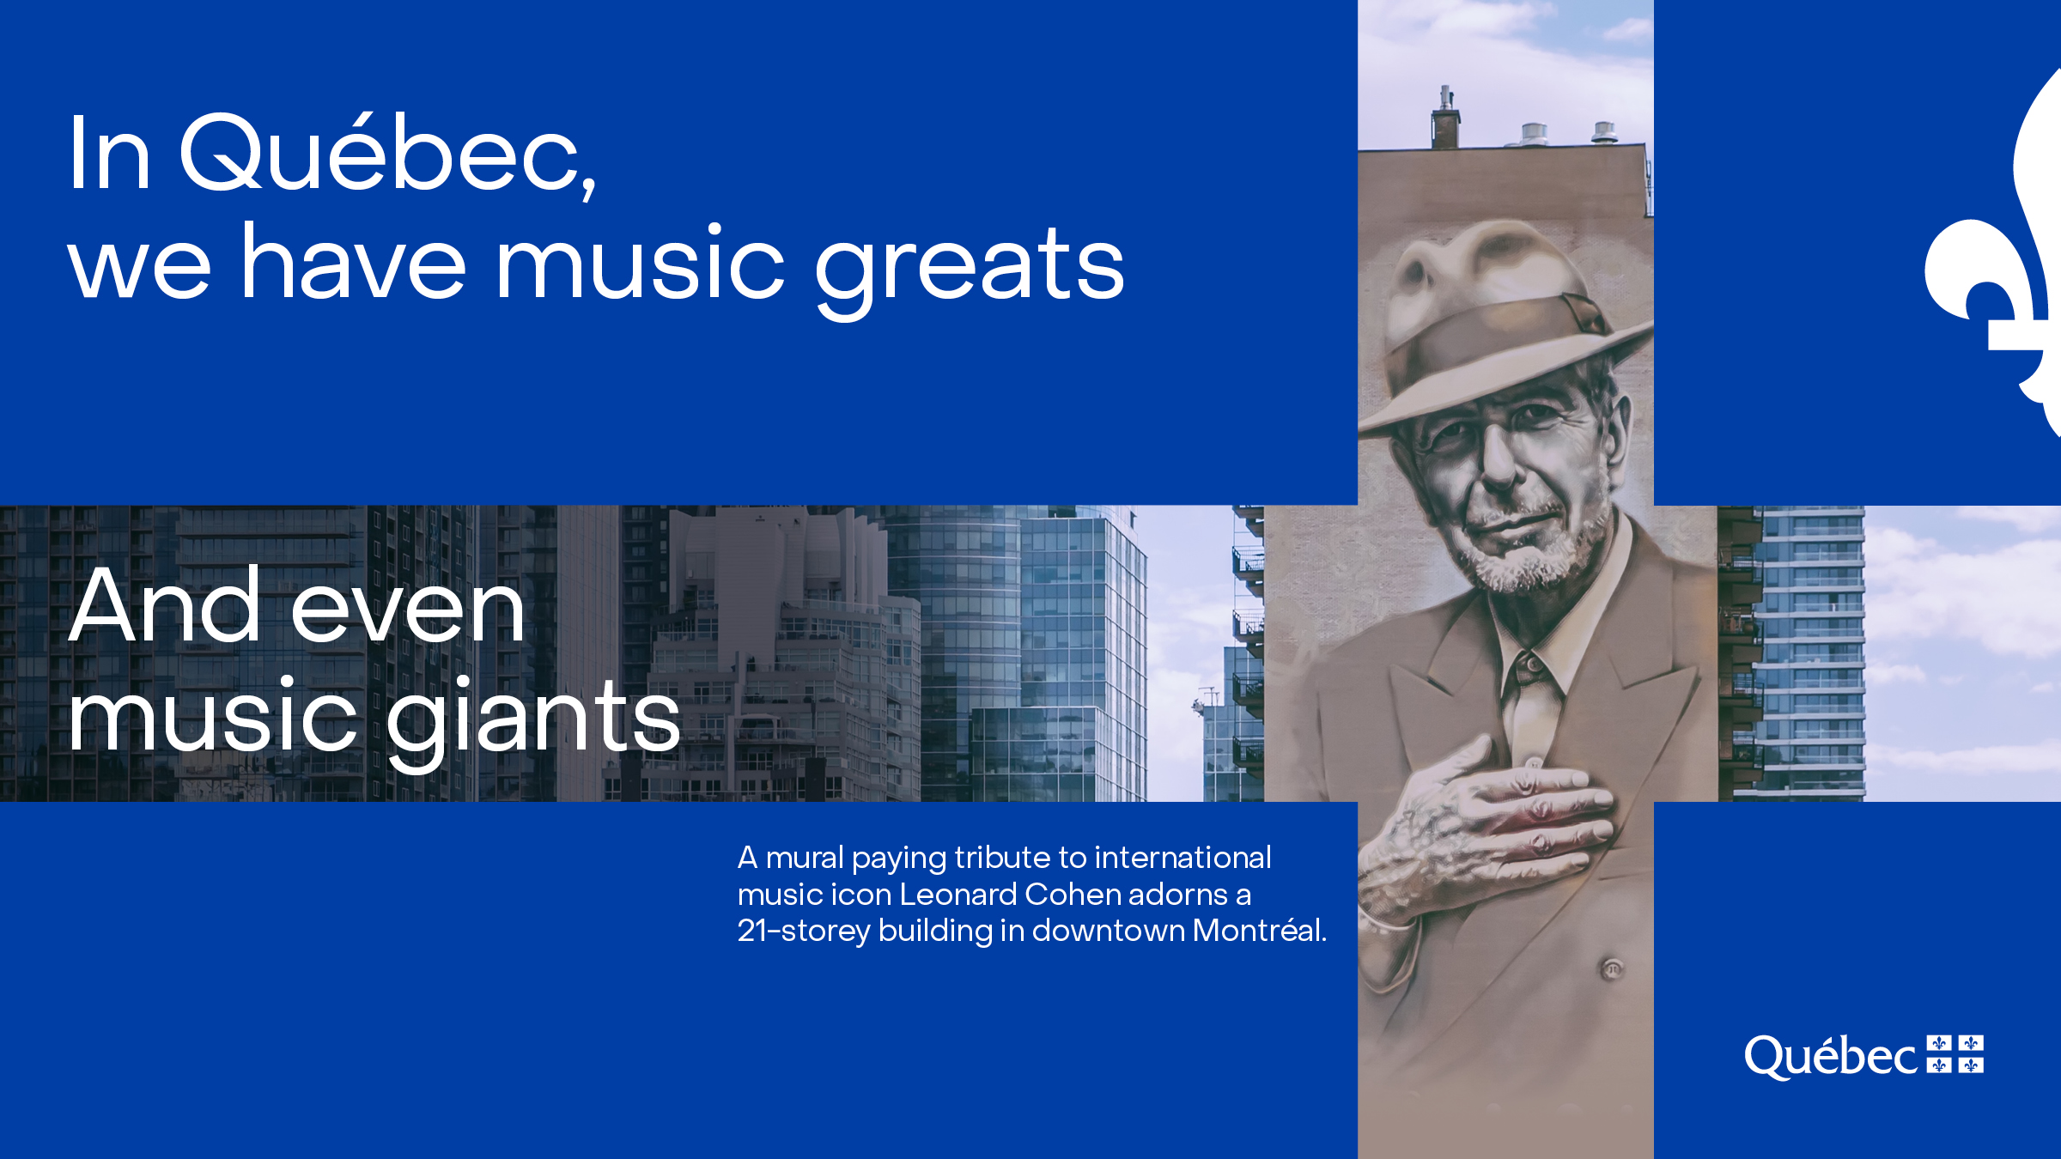

Slide 8
CIRCUS, COMEDY, DANCE AND THEATRICAL PERFORMANCES: GREAT WAYS TO EXPERIENCE A WHOLE RANGE OF EMOTIONS
Be astounded by the feats of Cirque Éloize’s acrobats
Let yourself be carried away by Robert Lepage’s theatrical ingenuity
Be enthralled by the innovative choreographies of the Marie Chouinard Company

Slide 9
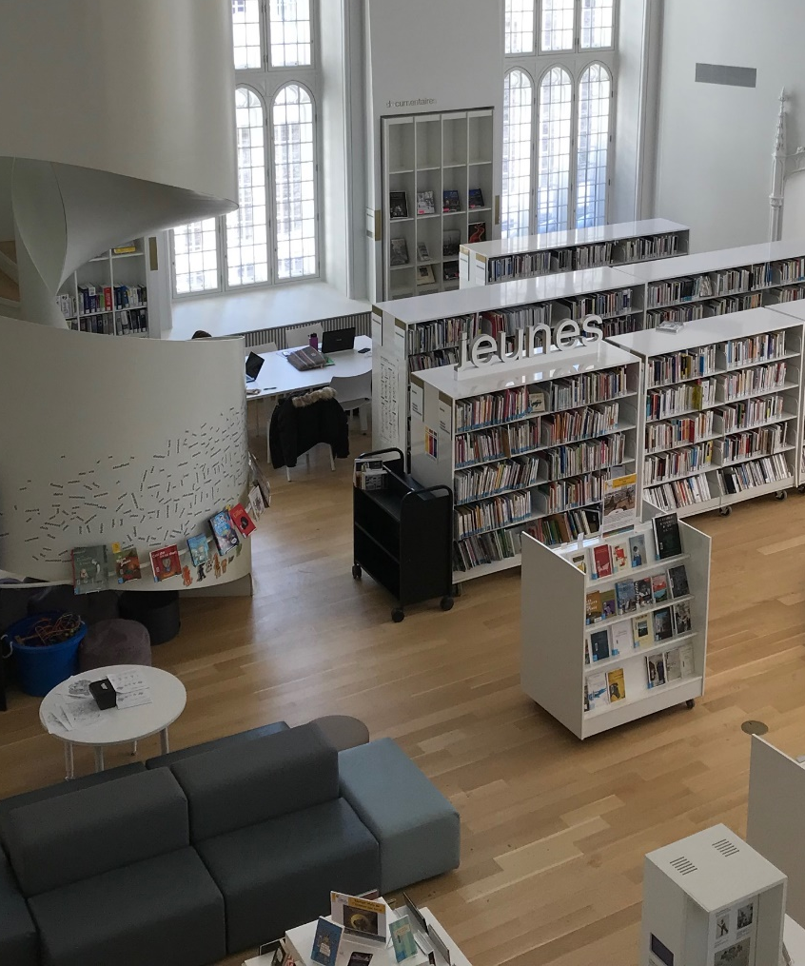
QUÉBEC LITERATURE: ORIGINAL, RICH AND DIVERSE
It is shaped by an incredible range of inspired and inspiring authors and illustrators.
Dany Laferrière, member of the Académie française
Dominique Fortier, 2020 Prix Renaudot, essay
Michel Jean, 2020 Prix littéraire France-Québec
Naomi Fontaine, 2020 Prix littéraire des collégiens
Michel Rabagliati, 2021 Prix de la série, Angoulême Festival
Maison de la littérature © Didi L.G.

Slide 10
ART EVERYWHERE YOU LOOK!
There are nearly 400 museums and more than 4,000 public art works in Québec that have come into being as a result of the government policy for integrating the arts into architecture.
Geneviève Cadieux, BGL and Dan Brault have produced works as a result of this policy.
When it comes to visual and digital arts, Québec artists dazzle in Québec and internationally.
Québec visual artists Marc Séguin and Nadia Myre have gained recognition around the world.
The immersive experiences created by Moment Factory, Félix and Paul, and Ex Machina provide unique entertainment.

Slide 11
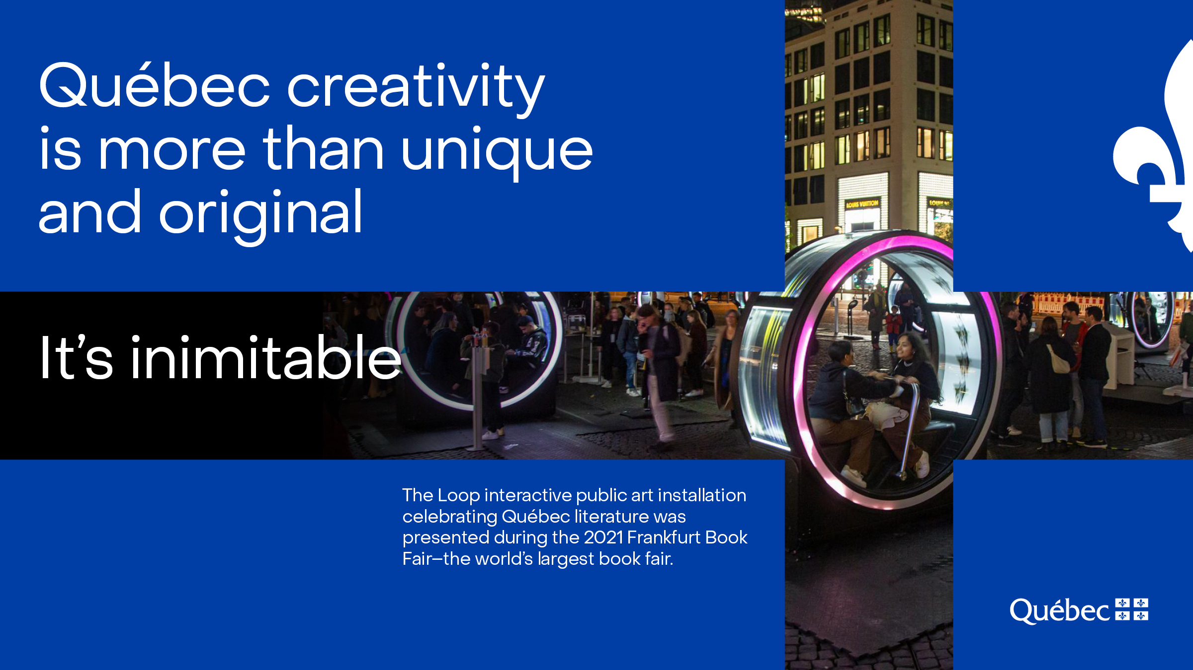
© Laura Nickel

Slide 12

QUÉBEC CINEMA IN THE SPOTLIGHT
Québec cinema stands out and is driven by the unique styles of award-winning filmmakers.
Denys Arcand
Louise Archambault
Anaïs Barbeau-Lavalette
Xavier Dolan
Jean-Marc Vallée
Micheline Lanctôt
Denis Villeneuve

Slide 13
REAPING THE BENEFITS OF QUÉBEC’S KNOW-HOW AND AVANTAGES
Access to outdoor filming locations that evoke present-day America or old Europe and that feature both natural and urban spaces.
Access to a refundable tax credit for shooting foreign productions and for technical services such as animation and special effects.
Co-production opportunities with Québec companies.
Numerous international exchange opportunities, including creative residencies and master classes.

Slide 14
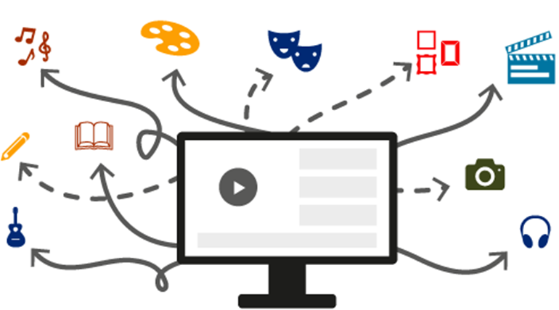
QUÉBEC CULTURE: DEEPLY ROOTED AND FUTURE ORIENTED
Accessible to an ever-growing
audience thanks to digital technology
In 2020, Québec and France agreed
on a joint strategy to promote the discoverability of our cultural
content in various digital markets
(in Québec, France and internationally).

Slide 15
Québec’s creativity shines the world over.

Slide 16
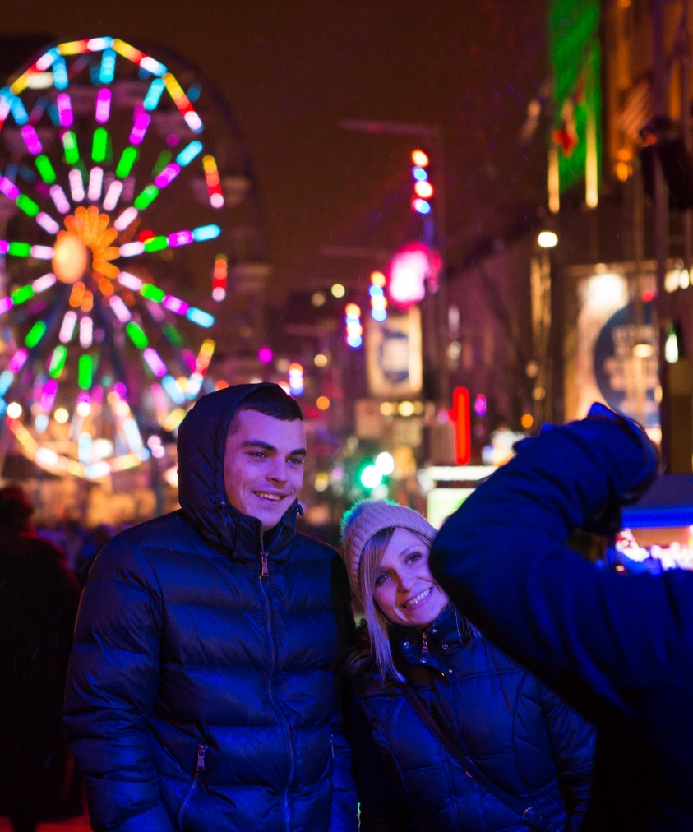
Culture is part of Quebecers’ DNA.
It is unifying, distinctive and appealing.
EXPERIENCE IT IN PERSON OR ONLINE AND BE AMAZED!
Montréal en lumières

Slide 17

Thank you!
Québec.ca/international

