Slide 1
Take flight with Québec’s dronautics industry
DATE

Slide 2

QUÉBEC: The perfect place to help dronautics take off
A well-developed, innovative ecosystem
Numerous Québec industries driving progress
Multiple sector-specific applications
A high-potential environment for collaboration

Slide 3
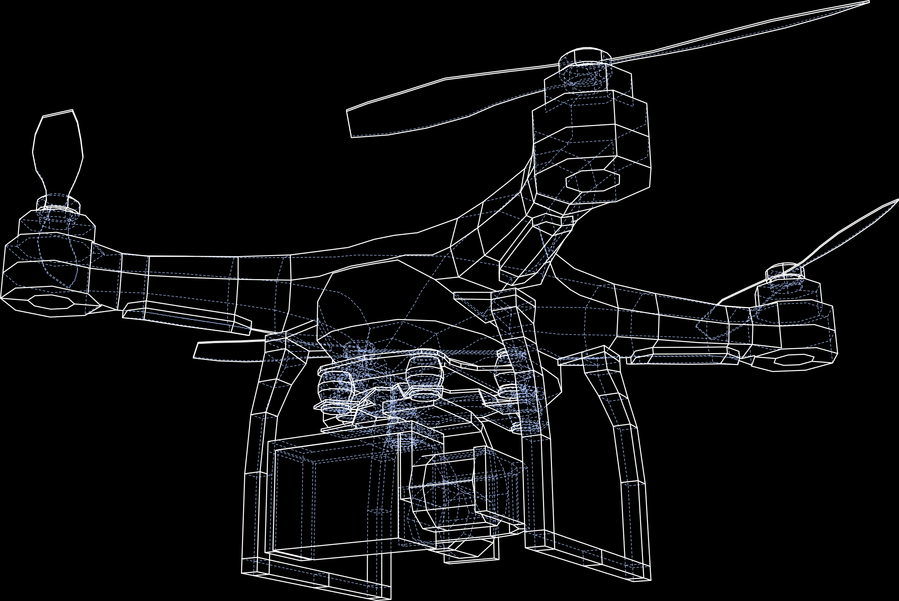
QUÉBEC’S DRONAUTICS industry by the numbers
96
5,000
18
businesses
jobs
innovative sector-specific projects
5
23
priority fields of application
supporting sectoral organizations

Slide 4
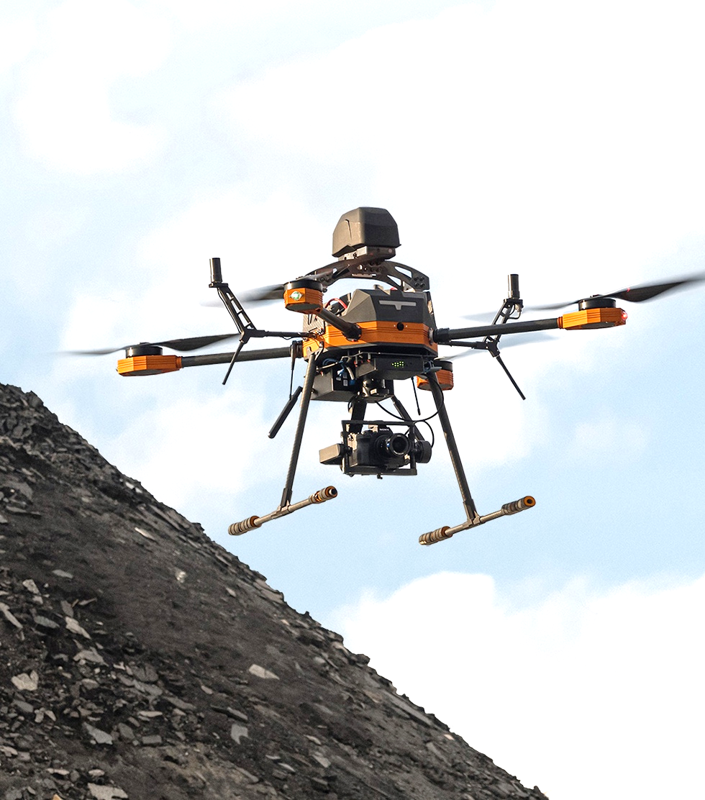
DRONAUTICS companies
Key players include development and manufacturing companies, operators, sensor and data processing specialists, system suppliers, and operating companies
A combination of prime contractors (OEMs), Tier 1 integrators, and smaller suppliers (SMEs and startups)
Training institutes, research and development centres, renowned testing infrastructures, and sectoral organizations
© ARA Robotique

Slide 5

A DRONAUTICS industry working in collaboration with industry
AEROSPACE
The aeronautics industry brings together major international compagnies and innovative SMEs. It is a strategic pillar of Québec’s economy and an exceptional driving force for the dronautics industry.
ARTIFICIAL INTELLIGENCE
Québec, particularly Montréal, is among the most dynamic artificial intelligence ecosystems in the world and plays a major role in propelling the dronautics industry forward.
PRIMARY INDUSTRIES
The dronautics sector creates products tailored to the real-world needs of companies in major industries like hydroelectricity and mining, ensuring that dronautics applications are efficient, practical, and directly beneficial for key sectors of the economy at home and abroad.

Slide 6
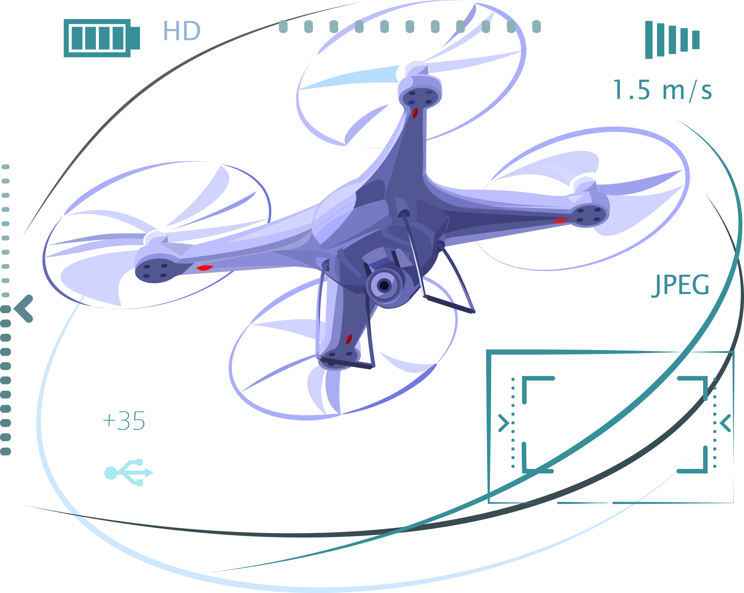
FIVE PROMISING fields of application
1
Safety and security
2
Infrastructure inspection
3
Agriculture and environment
4
Advanced air mobility
5
Medical

Slide 7



































INDUSTRY STAKEHOLDERS
Companies ready to deploy efficient dronautics technologies
Notes:
Ajout de:
DroneXperts
Spectral Aviation Inc
Lux Aerobot
AEKO Dronautique
Air Data
CMC électronique
Safran aerospace
CAE
Airbus
Bombardier
Pratt & Whitney
Bell textron
Rolls-Royce
Mitchell Aerospace
Altitude Aerospace
Avianor

Slide 8























INDUSTRY STAKEHOLDERS (continued)
An industry backed by numerous institutions and governmental bodies
Notes:
Ajout de:
Concordia
McGill
Laval
Polytechnique
ÉTS
UQAM
UQTR
École nationale d’aérotechnique, campus du cégep Édouard-Montpetit

Slide 9
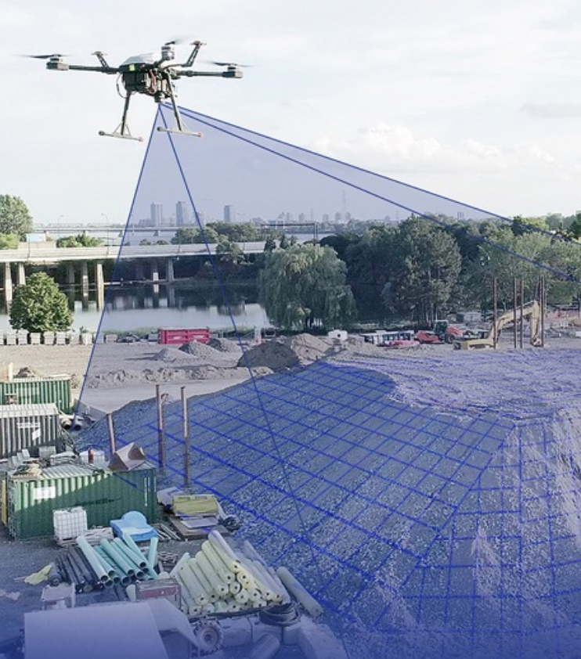
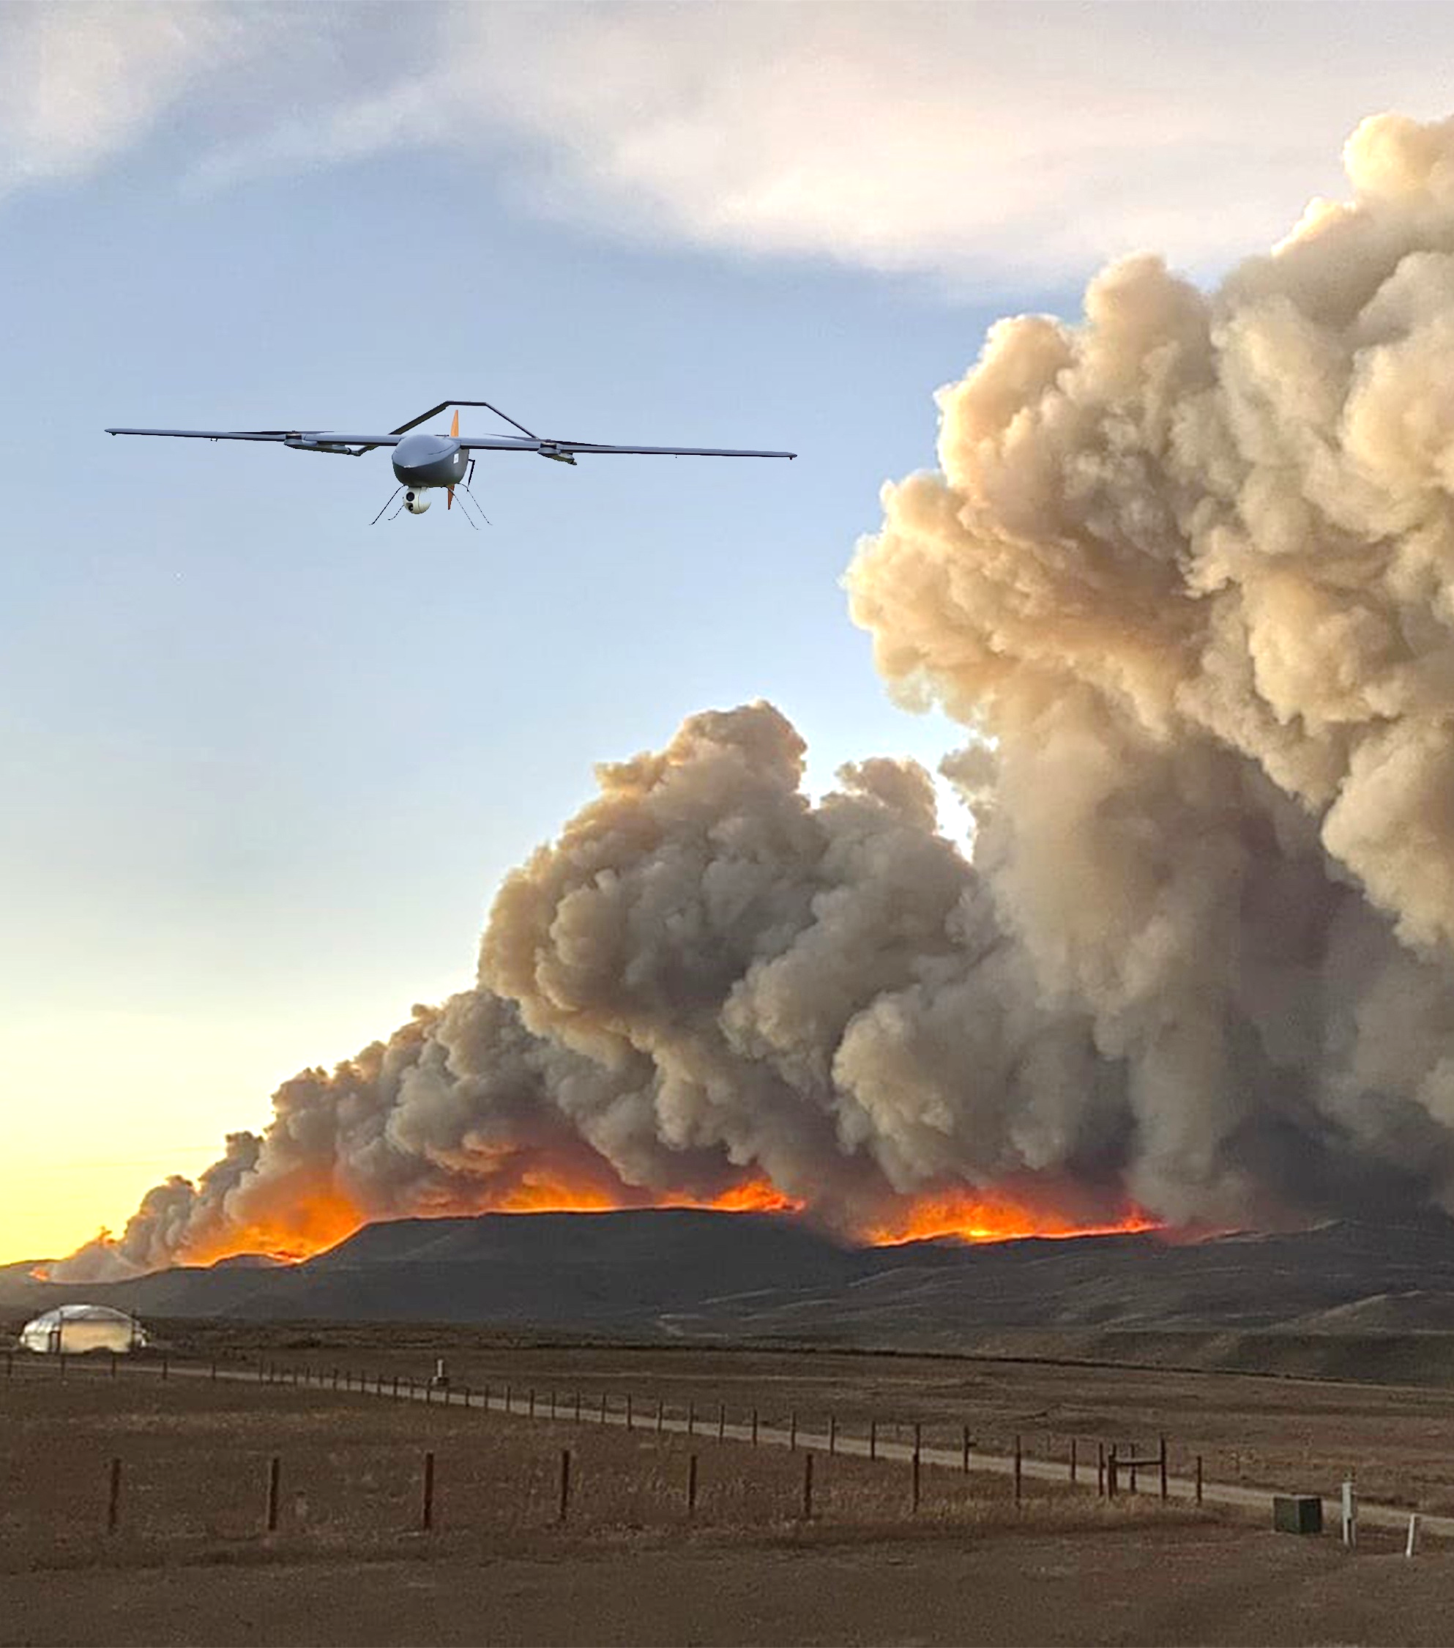
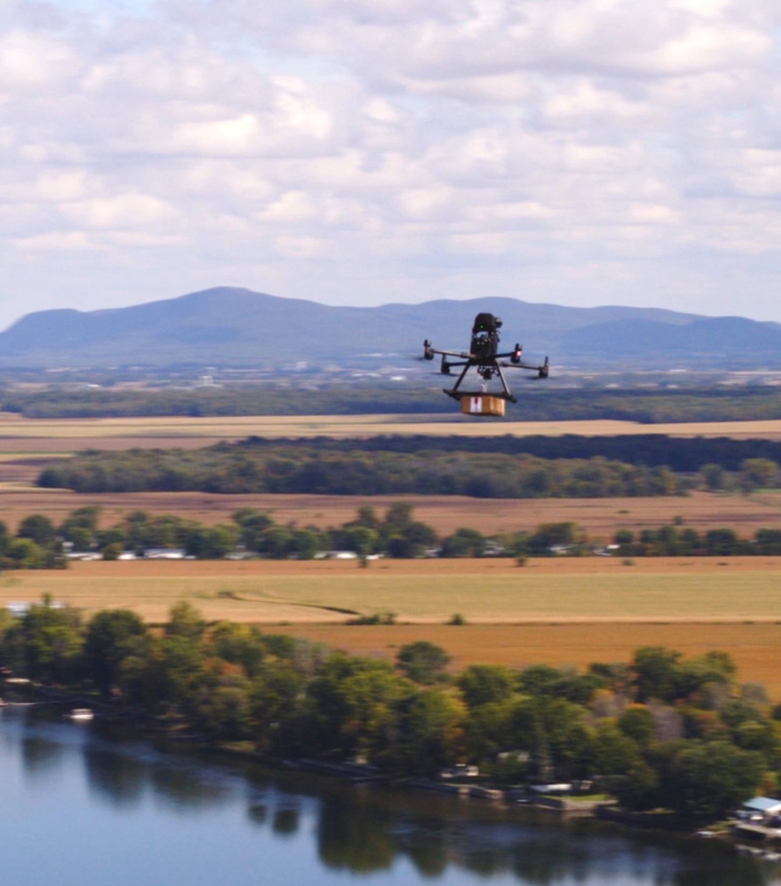
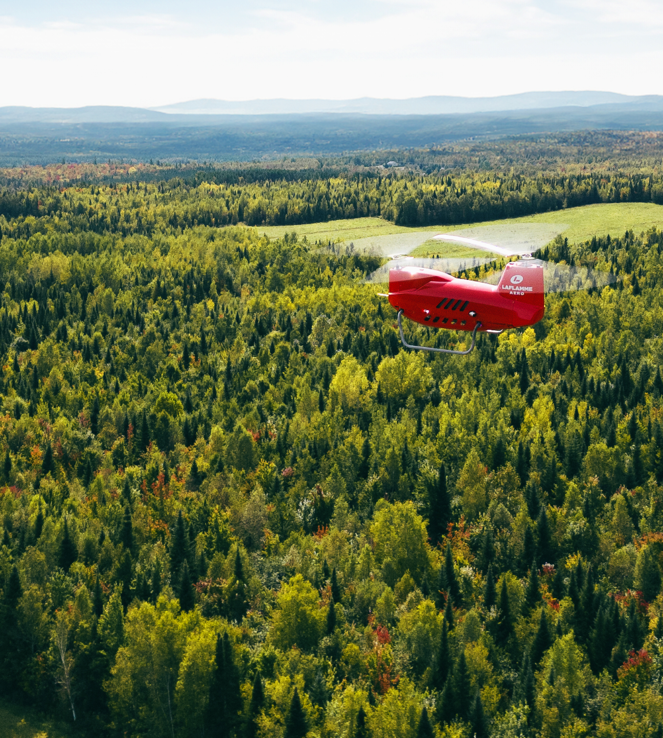
PROJECTS TAKING OFF with Québec’s dronautics industry
ARA ROBOTIQUE
Real-time surveying
A revolutionary solution that automates mapping and surveying processes on industrial sites.
EXO DRONE
SOPFEU project
A project focused on wildfire management, integrating advanced technologies for long-range drone flights.
EXO TACTIK
Ocellus initiative
A shared drone operation service serving a group of 10 municipalities and all their departments.
LAFLAMME AÉRO
Autonomous aerial drone delivery system initiative
A complete drone-based solution focused on transporting critical goods, capable of reaching remote regions and efficiently carrying out strategic deliveries.
@ARA Robotique
@Laflamme Aéro

Slide 10
ESPACE AÉRO Québec's Aerospace Innovation Zone
Positioning Québec as a global leader in smart and sustainable air mobility by building on its established expertise in research, innovation, and training
Aéro-Cité (Mirabel Hub)
Experimental flight corridor
Flight and testing infrastructure and equipment
Raising awareness about the emergence of a new industry sector
Technologies for Electric Air Mobility project
Airbus CRYSTAL Project
Aéro-Campus (Longueuil Hub)
New department of aerospace engineering
Hybrid Propulsion Center of Excellence
Flight certification and testing center
Aéro-Hub (Montréal Hub)
Indoor and outdoor drone flight performance testing centre
Advanced manufacturing and robotics experimentation
Indoor/outdoor flight enclosure
Advancing research and innovation

Slide 11



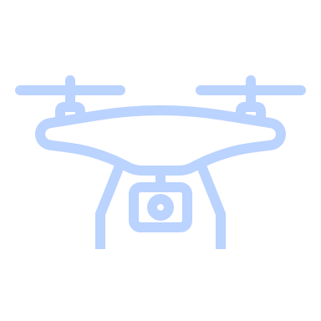
With you, QUÉBEC’S DRONAUTICS industry will continue its rise to soar worldwide
For any inquiries
FIRSTNAME LASTNAME
Title
418 XXX-XXXX
xxx@mri.gouv.qc.ca
For more information on the industry, we invite you to consult the microsite dronautiquequebec.com/en/.
Designed in close collaboration with Québec's dronautics ecosystem, the Ministère des Relations internationales et de la Francophonie and the Ministère de l’Économie, de l’Innovation et de l’Énergie.
Notes:
Ajouter les informations de la personne qui présente le document

