Slide 1


Slide 2
QUÉBEC : a leader in decarbonizing the global economy and protecting the environment

Slide 3


LE QUÉBEC
incomparable
renewable
electrifying
exportable
natural
inclusive

Slide 4

Incontournable Québec
Downtown view of Montréal
© Tourisme Montréal / Eva Blue

Slide 5

WE WILL
Continue to implement the Paris Agreement;
Build strategic alliances with our international partners to create a strong, innovative and sustainable global economy.

Slide 6
QUÉBEC IS
A key partner for decarbonizing the global economy and protecting the environment;
One of the places in North America with the lowest per capita greenhouse gas (GHG) emissions rate;
A North American carbon pricing pioneer with a high-performance carbon market;

Slide 7
WE ARE (following)
Recognized for our know-how and innovative measures in the renewable energy, electric transport, energy efficiency and green financing sectors;
A government committed to supporting businesses, organizations and citizens in their efforts to fight climate change.

Slide 8
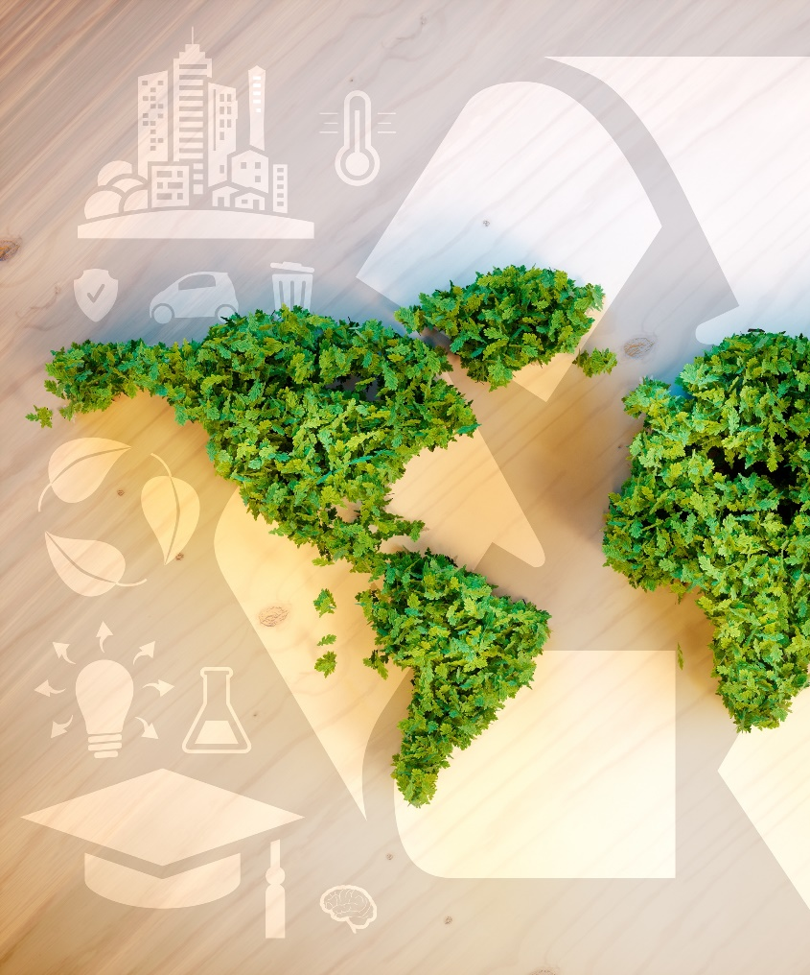
OUR OBJECTIVES
Reduce our GHG emissions by 37.5% below 1990 levels by 2030;
Achieve carbon neutrality by 2050.

Slide 9

Renouvelable Québec

Slide 10
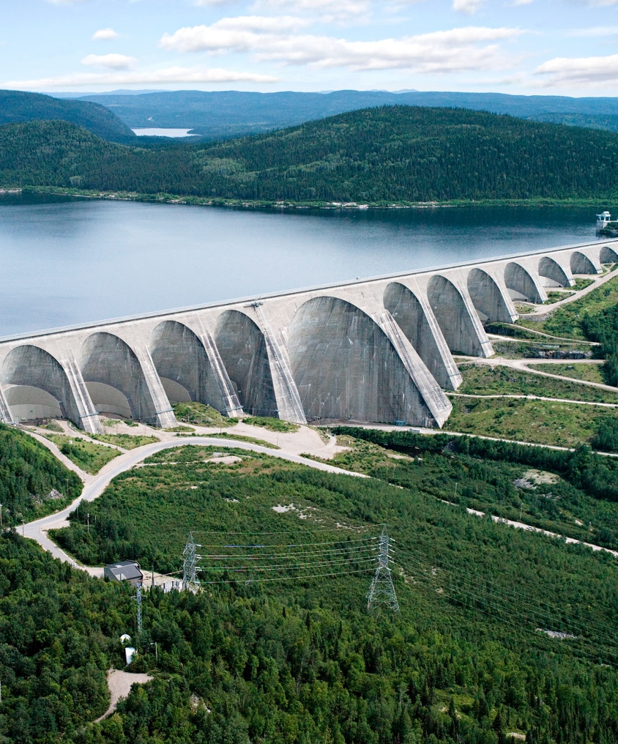
WE INTEND TO
Make Québec the green battery of Northeastern America;
Take advantage of our hydropower to electrify our economy;
Become a leader in the production of renewable energy to complement hydropower.

Slide 11
WE ARE
The world’s fourth largest producer of hydropower: a clean, reliable and abundant energy that is available at a competitive cost;
Recognized worldwide for our know-how in electricity production and transmission and the development of related technologies;
Cutting-edge experts on wind energy;
Home to rapidly-growing renewable energy sectors, including bioenergy, green hydrogen and renewable natural gas.

Slide 12

OUR OBJECTIVES
Boost Québec’s total renewable energy production by 25%;
Increase our bioenergy production by 50%.

Slide 13

Électrisant Québec

Slide 14
WE INTEND TO
Build on the clean, abundant and affordable electrical energy that Québec has at its disposal to launch a major electrification project in the transportation, buildings and industries sectors, which are the main GHG emitters in Québec;
Continue to support our partners in North America in achieving their own climate goals through the export of our hydroelectricity.

Slide 15
WE ARE
Canada’s largest electric vehicle (EV) market in terms of sales and charging infrastructure;
The second largest per capita market in North America for EVs, after California;
The first government in Canada to introduce a zero-emission vehicles act to promote the supply of electric vehicles;
Recognized for our know-how in transportation electrification, including heavy-duty and off-road vehicles (trucks, buses), charging stations and technologies, battery development, energy storage and strategic minerals.

Slide 16
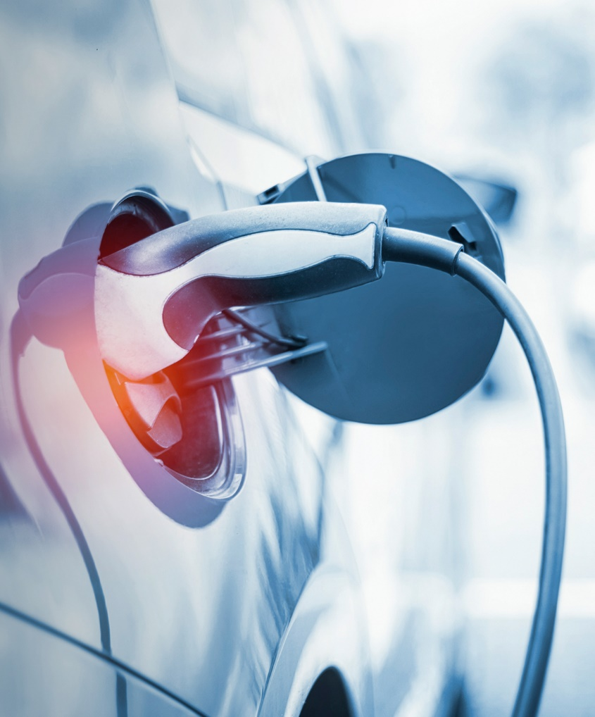
OUR OBJECTIVES
Prohibit the sale of new gasoline-powered motor vehicles as of 2035;
Have 1.5 million electric vehicles on the road in Québec by 2030;
Develop a standard on zero-emission vehicles for heavy vehicles.

Slide 17

Exportable Québec

Slide 18

WE INTEND TO
Contribute to the global effort by exporting our green technologies and know-how.

Slide 19
WE HAVE
Significant mineral resources to be exploited sustainably for the manufacture of electric vehicle batteries (nickel, graphite, titanium, cobalt, lithium and phosphate);
A booming electric battery ecosystem;
Direct access to the North American market by rail, ship or road as a result of numerous international trade agreements.

Slide 20
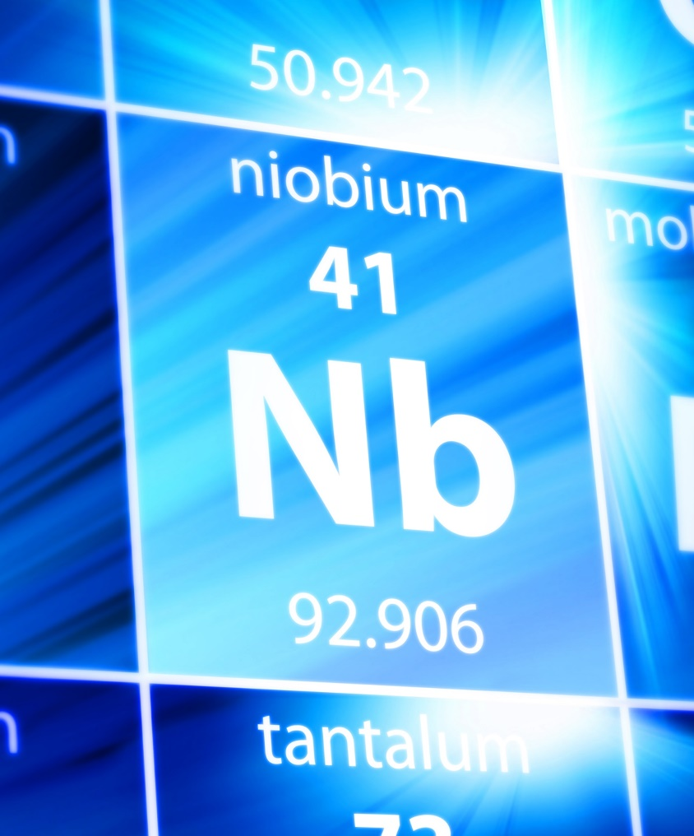
OUR OBJECTIVES
Become a major player on the world stage, from mining to recycling critical and strategic minerals, including reprocessing, purifying and generating value from mine waste;
Produce one of the world’s cleanest batteries;
Locally produce electric commercial and off-road vehicles.

Slide 21

Naturellement Québec

Slide 22
WE ARE
An actor committed to the conservation of our territory’s biodiversity, in close consultation with local and Indigenous communities;
Home to the Secretariat of the United Nations Convention on Biological Diversity;
A pioneer in sustainable agriculture that rewards the best agri-environmental practices that respect agrobiodiversity;
An expert in the protection and enhancement of wildlife;

Slide 23
WE ARE (following)
Recognized for having one of the most rigourous forest regimes in the world;
Recognized for having a mining regime that combines environmental protection, land-use coordination, social acceptability, economic benefit sharing and transparency;
Innovative and committed to the rehabilitation of mine sites.

Slide 24

OUR OBJECTIVES
Actively pursue our international commitment by supporting the upcoming post-2020 global biodiversity framework;
Continue to be a committed member of biodiversity collaboration and knowledge sharing networks among subnational governments;
Ensure the framework’s effective implementation throughout Québec’s vast territory.

Slide 25

Collectif Québec

Slide 26

WE INTEND TO
Support the efforts of developing countries that are most vulnerable to the impacts of climate change by strengthening their adaptation capacity and limiting their greenhouse gas emissions.

Slide 27
WE ARE
The first federated state to establish an International Climate Cooperation Program (ICCP) financed by revenue from its carbon market;
A proactive and committed player in international climate finance through our contributions to multilateral climate funds and the development of partnerships with international organizations such as the Food and Agriculture Organization (FAO).

Slide 28

OUR OBJECTIVES
Continue our international climate cooperation actions with developing countries and regions, including those that are the most vulnerable to the impacts of climate change.

Slide 29

Thank you!
Sous-titre du diaporama
Québec.ca/international

