Slide 1
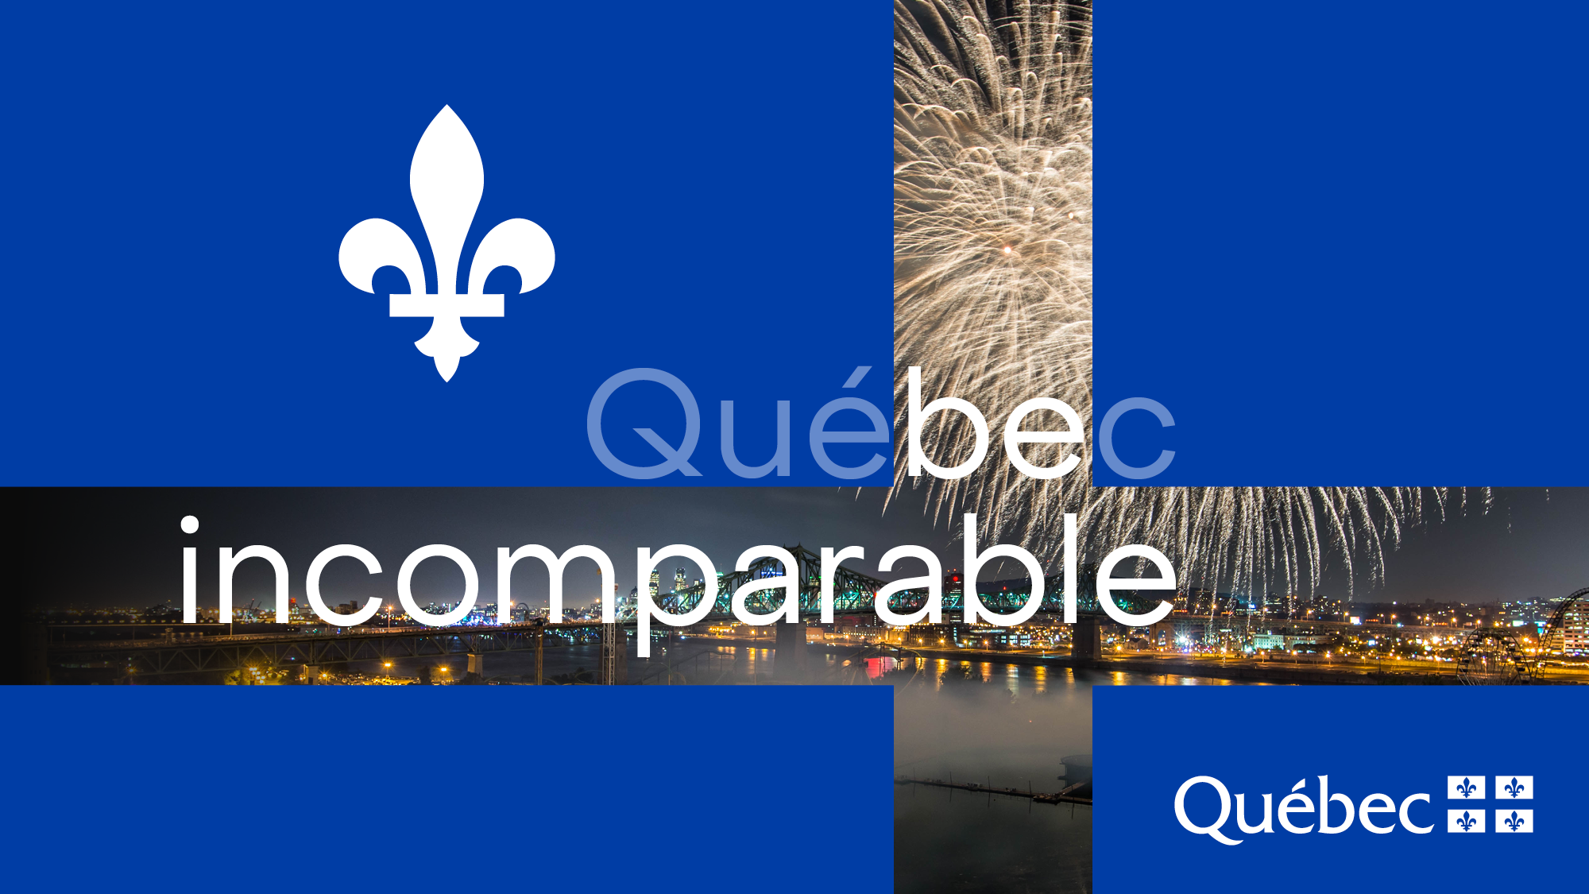
L’International des Feux Loto-Québec © Tourisme Montréal / La Ronde

Slide 2


QUÉBEC
A successful, inspiring and accessible business environment
Vast land
Abundant renewable resources
Unique areas of excellence in North America
Parc du Mont-Royal © Tourisme Québec / iStock-swissmediavision

Slide 3

Lac des Trente et Un Milles, Outaouais © Tourisme Québec / Gaëlle Leroyer

Slide 4
Population
Almost
8.6
23 %
%
million
of the Canadian population
80
45
%
%
of the population is French-speaking
of the population speaks both French and English

Slide 5

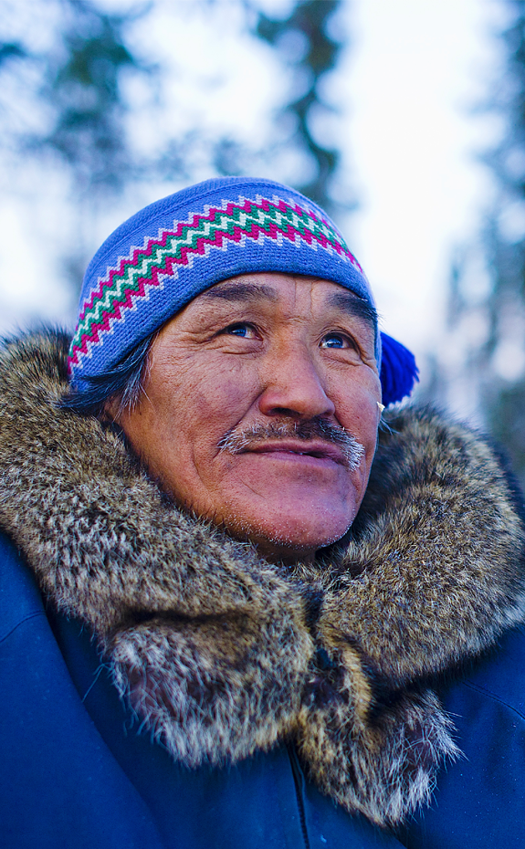
DIVERSITY
Eleven recognized Indigenous Nations: Abenaki, Algonquin, Attikamek, Cree, Huron-Wendat, Innu, Wolastoqiyik, Mi’kmaq, Mohawk, Naskapi and Inuit.
Diverse population: In 2019, Québec welcomed more than 40,000 people from 150 countries.
Nunavik © Tourisme Québec / Tourisme Nunavik–C. Migeon

Slide 6


Slide 7


EQUAL OPPORTUNITIES FOR ALL
Universal health insurance scheme that guarantees free healthcare
Accessible education for all at the university level
Forward-thinking family policy:
Public parental leave plan
Subsidized daycare network (childcare centres)
Terrasse Dufferin © Tourisme Québec / Steve Deschênes

Slide 8
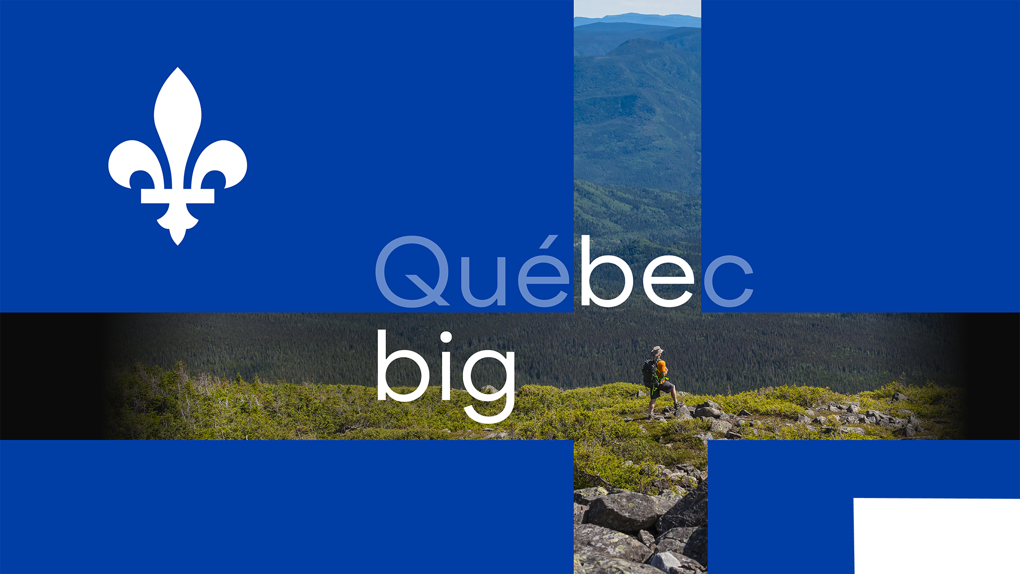
Parc national des Grands-Jardins, Charlevoix © Tourisme Québec / Steve Deschênes

Slide 9
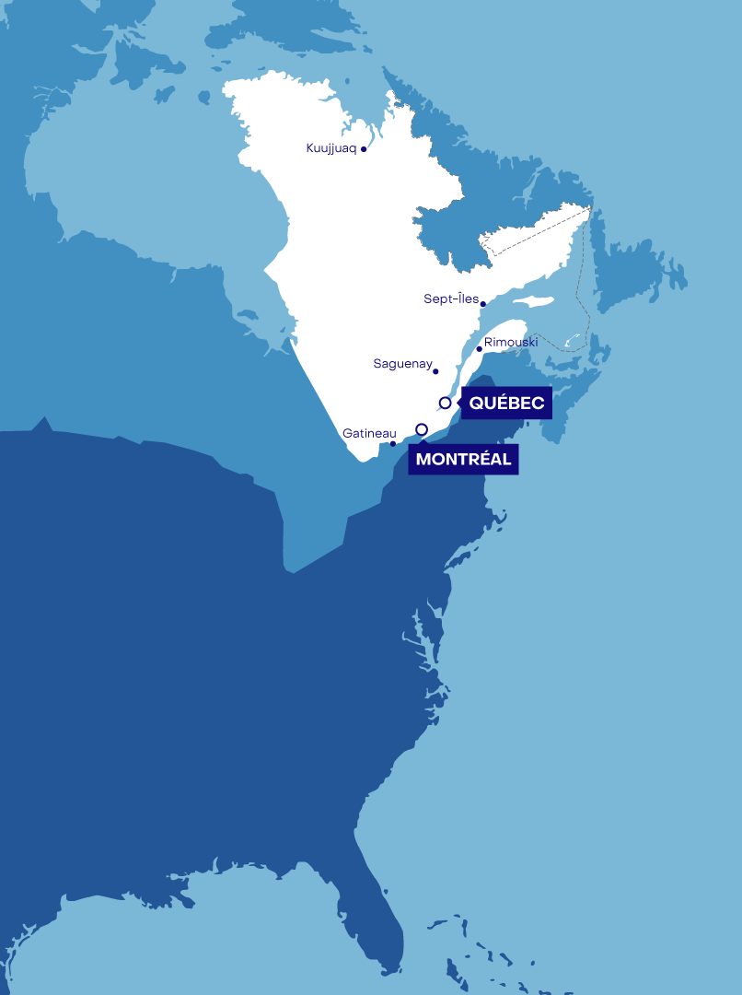
Located in northeastern North America
1.67 million square kilometres
Largest of the 10 Canadian provinces
Territory equivalent to
2 ½ x
the size of Texas
3 x
the size of France
5 x
the size of Japan
Four very distinct seasons
From -30°C in January to +30°C in July!

Slide 10


Slide 11
With
4,500 rivers
Québec’s forests cover nearly 761,000 km² =
2
and
500,000 lakes
20
of Canada’s
forests
of the world’s
forests
%
%
3
of the world’s renewable freshwater reserves
%
Size of Sweden
and Norway combined!
3rd
largest freshwater reserve in the world

Slide 12
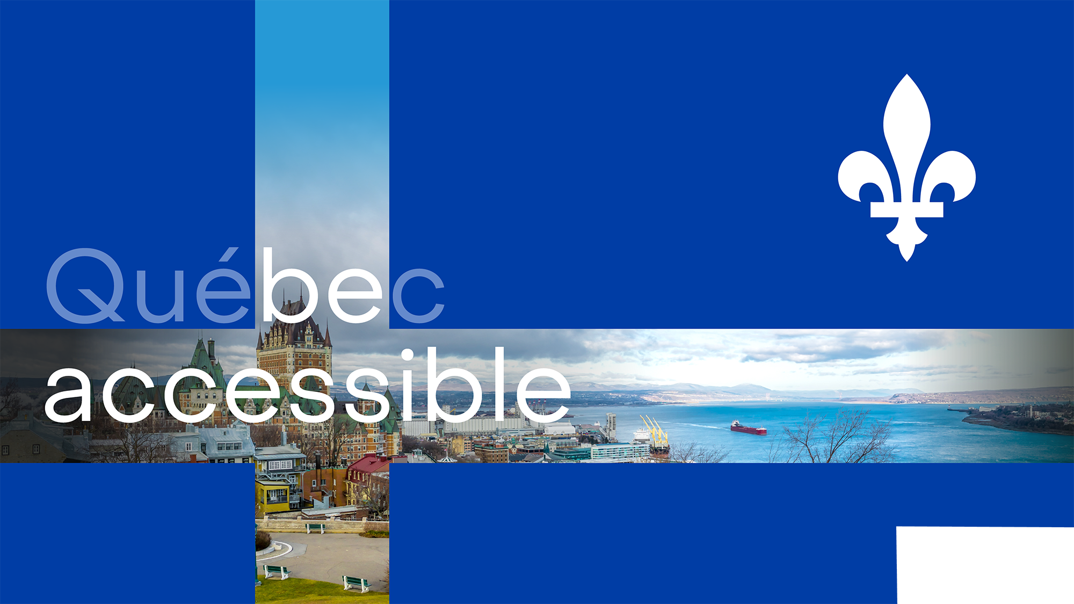

Slide 13

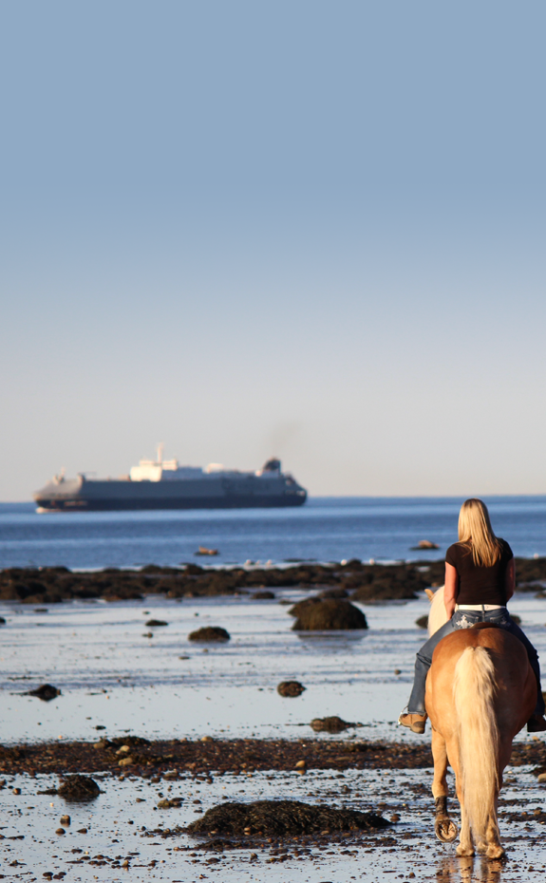
ST. LAWRENCE RIVER
1,200 km long, one of the world’s major waterways and the largest waterway in North America
Direct access to the heart of North America year-round
Shortest route from Europe to the American Midwest
Major corridor for North American maritime trade relations
Les Haflinger du Fjord, Charlevoix © Tourisme Québec / Guillaume Poitras

Slide 14

Drapeaux Francophonie © Ministère du Conseil exécutif / Patrick Lachance

Slide 15
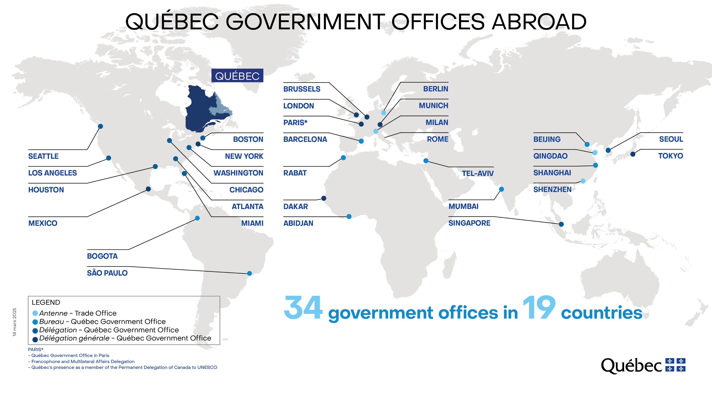
AN AMBITIOUS DIPLOMATIC NETWORK

Slide 16

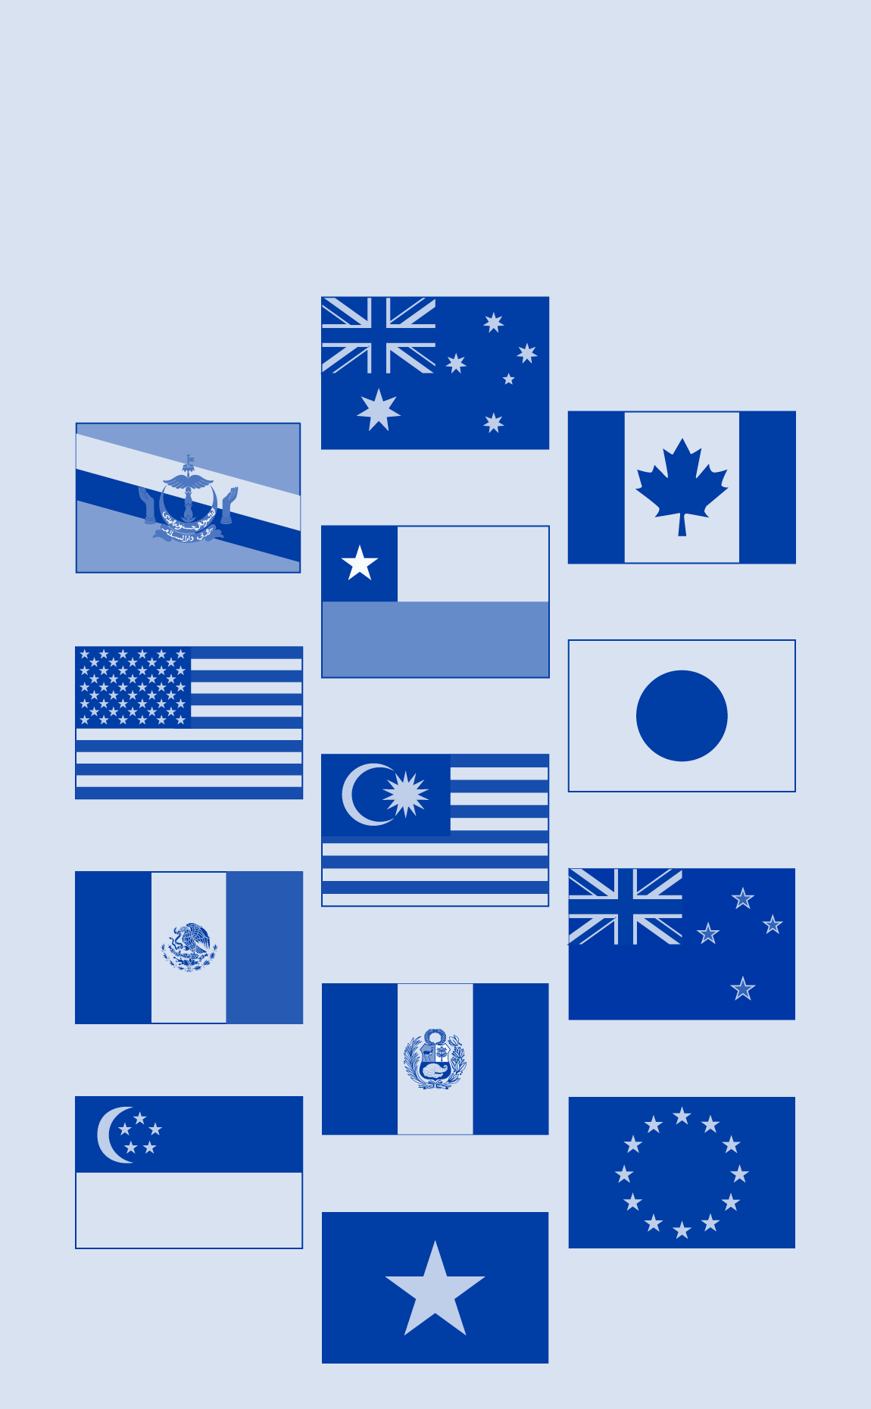
INTERNATIONAL AGREEMENTS
Québec benefits from several major international agreements:
Canada–United States–Mexico Agreement (CUSMA)
Comprehensive Economic and Trade Agreement (CETA) between Canada and the European Union
Comprehensive and Progressive Agreement for Trans-Pacific Partnership (CPTPP)

Slide 17

Indispensable Québec
Fête nationale du Québec © Tourisme Québec / Denis Poulin

Slide 18

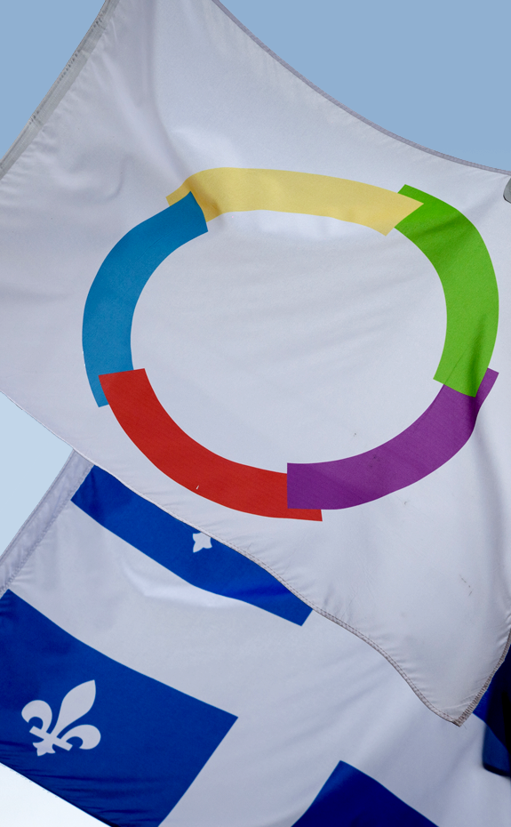
FRENCH-SPEAKING STATE
Full member of the International Organization of La Francophonie (IOF)
A major player in La Francophonie

Slide 19

Rentable Québec

Slide 20
ECONOMY
98
92
GDP of nearly
$470
billion
Almost
of the Canadian economy
Lowest unemployment rate in Canada
%
%
20
of companies in Québec are small and medium enterprises (SMEs)
of private-sector jobs are in SMEs
%

Slide 21
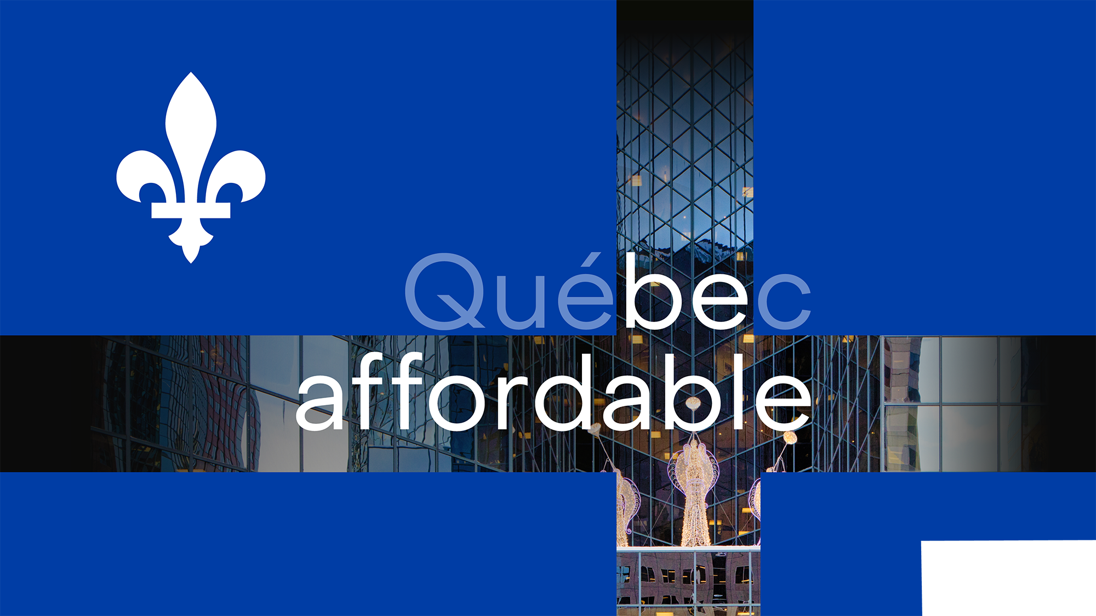
Abordable Québec
Downtown Montréal

Slide 22

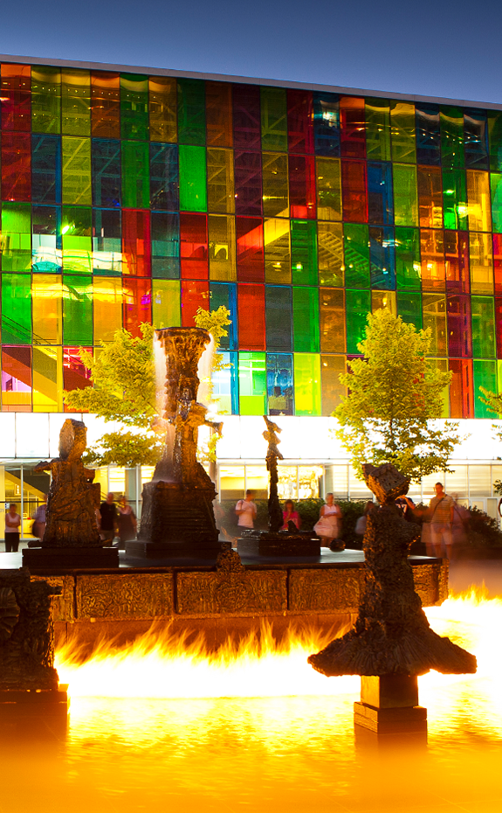

COST-EFFECTIVE
Québec is a strategically located North American hub:
Cost-effective rental space and one of the most competitive tax rates in North America.
Highly competitive operating costs: electricity is 36% cheaper than in the United States and 49% cheaper, on average, than in the G7 countries.
Financial incentives and very advantageous tax framework.
Palais des congrès de Montréal © Tourisme Québec / Mathieu Dupuis

Slide 23

Audacieux Québec

Slide 24

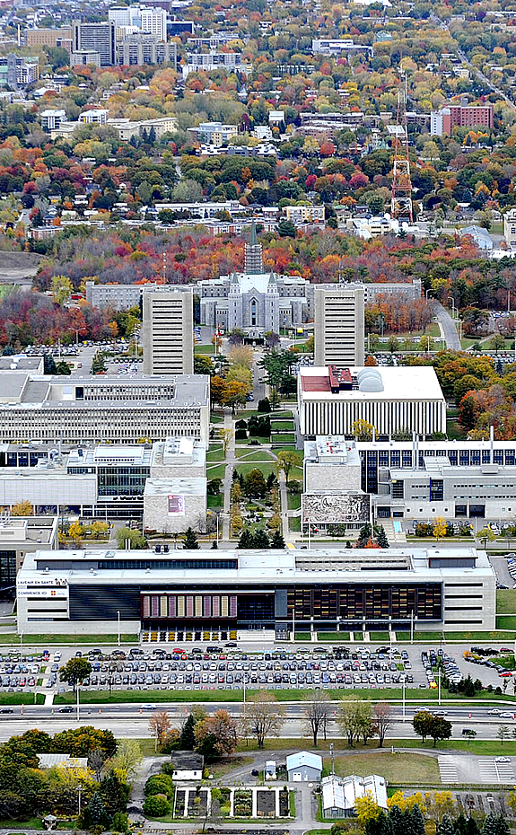
INNOVATION, RESEARCH AND DEVELOPMENT
R&D spending: $9,586M, or 2.17% of Québec’s GDP (2018)
More than a quarter of Canada’s R&D spending
Québec: 12th in the world in terms of GDP spent on R&D (2017)
Université Laval © Marc Robitaille

Slide 25
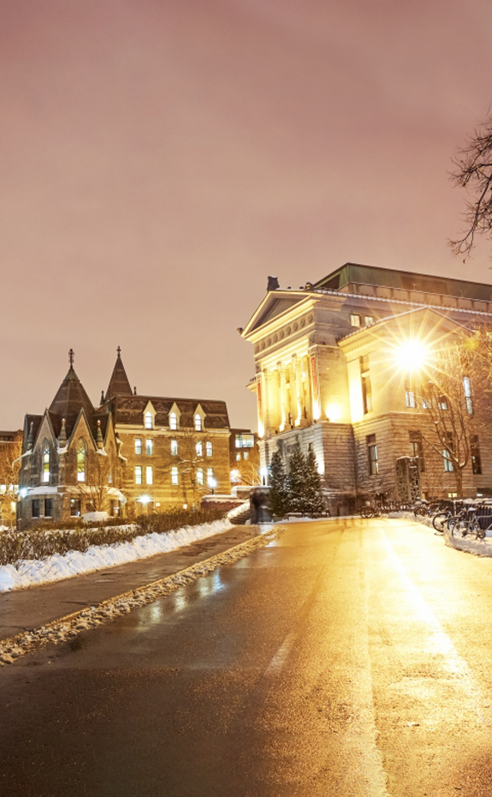
INNOVATION, RESEARCH AND DEVELOPMENT
32% of business R&D jobs in Canada are in Québec.
Three of the seven most research-intensive universities in Canada are in Québec: McGill University, Université de Montréal and Université Laval.
McGill University © McGill University

Slide 26

Unique Québec

Slide 27

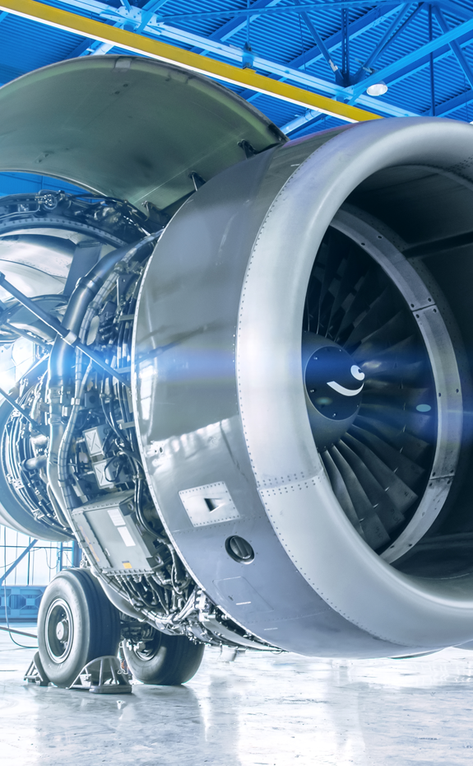
AEROSPACE
MONTRÉAL
largest aerospace capital
in the world after Toulouse and Seattle
Headquarters of the International Civil Aviation Organization (ICAO)
3rd

Slide 28
AEROSPACE
IN QUÉBEC
$17.8
billion in sales
(6th worldwide)
12
%
43,400 people
of manufacturing exports
220 SMEs and most of the major industrial contractors
Over
of R&D in Canada
50
%
70
%
of aerospace industry activity in Canada

Slide 29

Incomparable Québec

Slide 30


ARTIFICIAL INTELLIGENCE
Québec is a world leader in the field of artificial intelligence (AI):
Investments of over $475 million since 2017 to support AI research and implementation.
In 2019, $329 million over 5 years was invested to accelerate adoption.

Slide 31
ARTIFICIAL INTELLIGENCE
MONTRÉAL REGION
AI ecosystem contributing over $11 billion to Québec’s GDP
Canada’s leading city for AI R&D investment
More than 600 researchers and students, the largest concentration
of researchers in the world (Mila)
International Observatory on the Societal Impacts of AI and Digital Technology (OIISIAN)
More than 20 research chairs and laboratories for data use (IVADO)
95,000 specialists are employed in AI-related jobs

Slide 32

Authentique Québec
Tasting of regional products, Montérégie © Tourisme Québec / Dominique Lafond

Slide 33

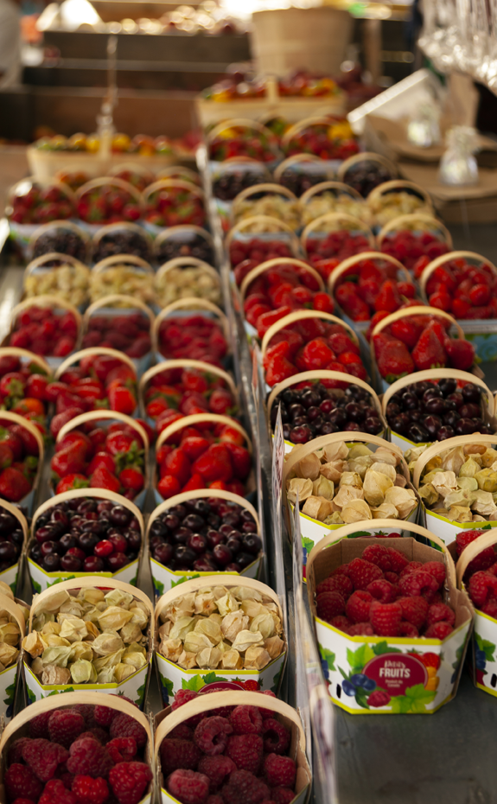
ORGANIC FOOD
Québec stands out for:
The quality and diversity of its products;
Its rich rural heritage and abundance of fresh, high-quality products;
Its innovation driven by collaboration between agri-food companies, research centres, and producer organizations.
Marché Jean-Talon, Montréal © Tourisme Québec / André Quenneville

Slide 34
ORGANIC FOOD
IN QUÉBEC
Over
of the world’s maple syrup production
More than
of sales are made outside Québec
Nearly 30,000 farms
Largest pork producer in Canada
70
50
%
%

Slide 35


Slide 36

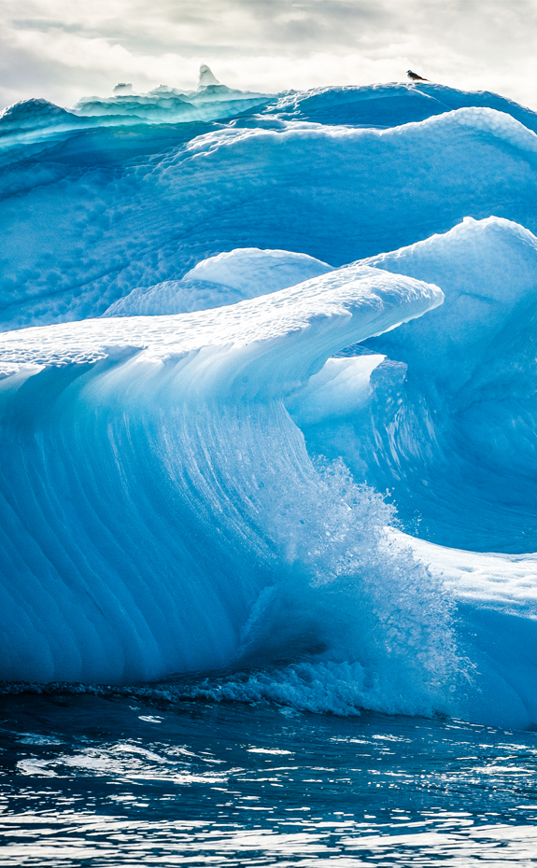
ENVIRONMENT AND THE FIGHT AGAINST CLIMATE CHANGE
Québec: lowest per-capita greenhouse gas (GHG) emissions of all U.S. states and Canadian provinces.
In line with the Paris Agreement, Québec has set ambitious GHG emission reduction targets: a 37.5% reduction by 2030 and carbon neutrality by 2050.
Effective tools to achieve those targets, notably with the Québec-California carbon market.
Nearly 45% of all electric cars in Canada are in Québec.

Slide 37
ENVIRONMENT AND THE FIGHT AGAINST CLIMATE CHANGE
2021
Introduction of a Plan for a Green Economy (2030 PGE) with bold measures and investments of $6.7G.
Québec announces the end of hydrocarbon extraction in its territory.
Major hydroelectricity export contracts with Massachusetts and New York.
Our ambitions
Produce one of the world’s cleanest batteries.
Actively develop the green hydrogen sector with Hydro-Québec.
Make Québec the green battery of northeastern America!

Slide 38

Électrisant Québec

Slide 39

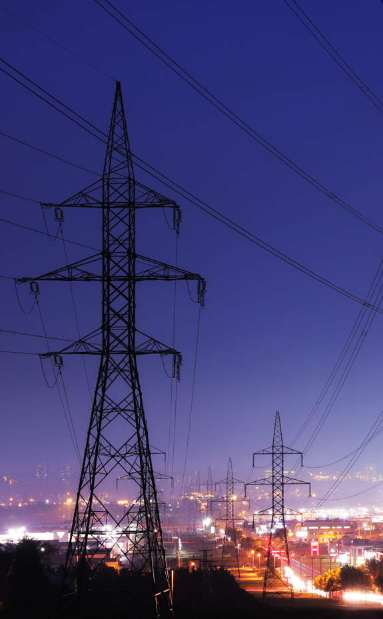
HYDROELECTRICITY
MAJOR ASSET
More than
of all electricity generated in Québec comes from hydroelectric sources
99
%

Slide 40
HYDROELECTRICITY
QUÉBEC
4th
Québec’s transmission lines are so long they could go around the Earth six times
largest hydroelectric producer in the world
One of the largest transmission systems in North America
Inexpensive: an undeniable competitive advantage in the North American market
Allows Québec to play an active role in transport electrification

Slide 41

Exportable Québec

Slide 42

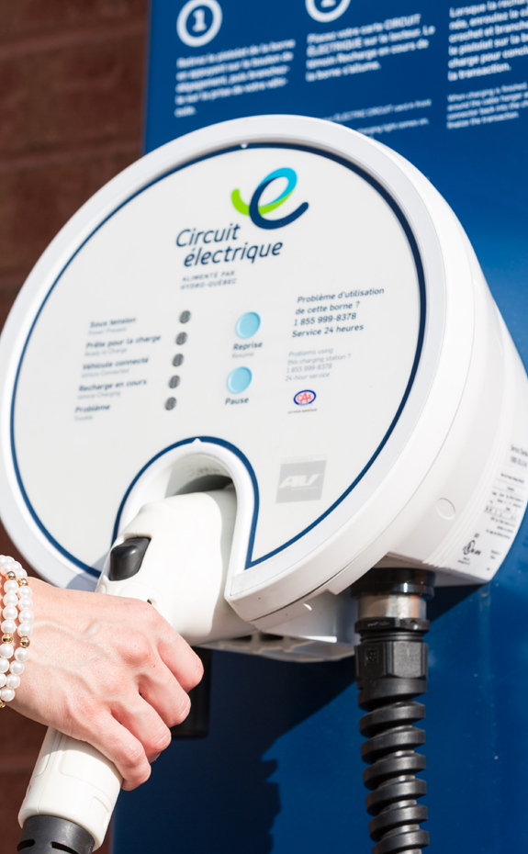
TRANSPORT ELECTRIFICATION
A booming industrial sector in Québec
Electric and Smart Transportation Cluster: some 150 smart, productive and innovative companies
Over 6,240 jobs
$2.2B in sales and $830M in goods and services exports

Slide 43
TRANSPORT ELECTRIFICATION
EXPERTISE
Buses, recreational and specialized vehicles, smart and electric vehicles, charging systems and batteries
From 2019 to 2020, the number of electric vehicles in Québec increased by 35%
Target of 1.5 million electric vehicles on Québec’s roads by 2030

Slide 44

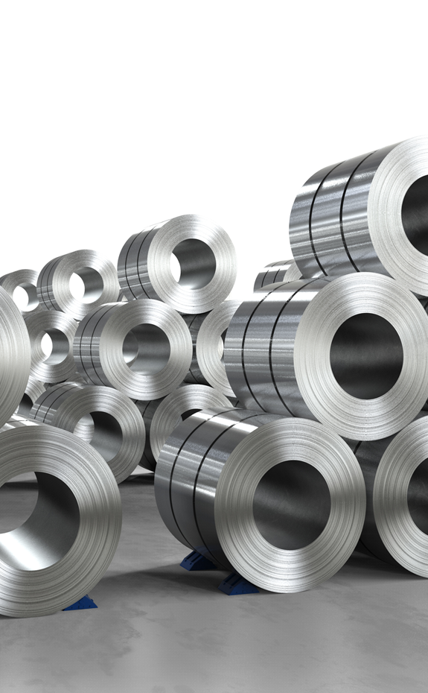
ALUMINUM
largest producer of primary aluminum in the world
World-class primary producers: Alcoa, Rio Tinto and Alouette
4th

Slide 45
9
smelters
96
2.9 million tons
of primary aluminum
equipment manufacturers,
processors and specialized suppliers
(construction, maintenance and operation of aluminum smelters)
60
%
of North American capacity

Slide 46
ALUMINUM
PROCESSING
923
684
132
8
manufacturing
companies
suppliers
recyclers
research, development and training
centres
World’s greenest aluminum produced 100% from hydroelectricity!

Slide 47


LIFE SCIENCES
More than
660 companies
employing over
32,000 people
Several large multinationals in the biopharmaceutical and medical device sectors
More than 20 public and university research centres
More than 10,000 scientists hold public-sector positions in the health sciences
Three university hospital research centers (CHUM, RI-MUHC and CHU Sainte-Justine) joined forces to make Montréal a global centre of expertise in early stage clinical trials

Slide 48

LIFE SCIENCES
EXPERTISE
Biotechnology
Contract research (drug development)
Biopharmaceutical manufacturing
Medical technology (hardware and digital health)

Slide 49

Merveilleux Québec

Slide 50


MULTIMEDIA AND VIDEO GAMES
ADVANCED CREATIVE EXPERTISE
Video games, virtual reality, visual effects (including post-production) and animation.
More than 11,000 people in Québec work in the video game industry, representing more than half of the industry’s jobs in Canada (2017).

Slide 51
MULTIMEDIA AND VIDEO GAMES
MONTRÉAL
5th
1st
500
32
200
%
largest video game centre in the world
Canadian city for visual effects and animation
film production and distribution companies
36 companies or studios specializing in visual effects and animation
of Canada’s animation production
international productions have been produced in Montréal in the past 5 years

Slide 52

Thank you!
Québec.ca/international

