Slide 2
A gateway towards maritime innovation

Slide 3
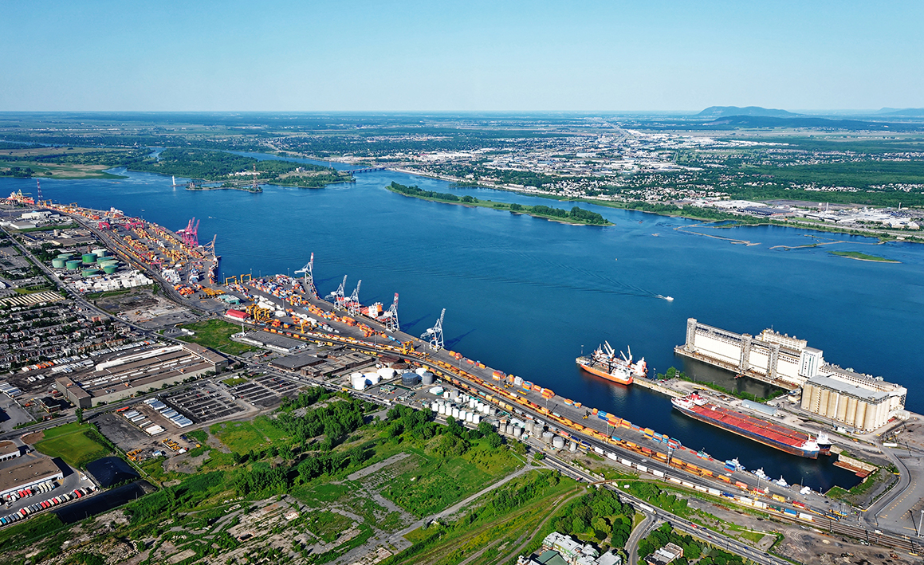
THE QUÉBEC MARITIME INDUSTRY
Qualified
Unique
Navigable
Sustainable
Blue
Innovative
Accessible
Proactive
Forward-thinking

Slide 4





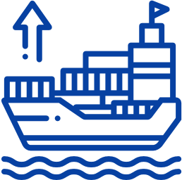
THE QUÉBEC MARITIME INDUSTRY In numbers
400
businesses
27,000
jobs
CA$2.8B
of the Québec GDP
75%
of transit is international
156 million
tons of goods
1/3 in imports and 2/3 in exports
Source: Société de développement économique du Saint-Laurent, État du transport maritime au Québec 2023

Slide 5
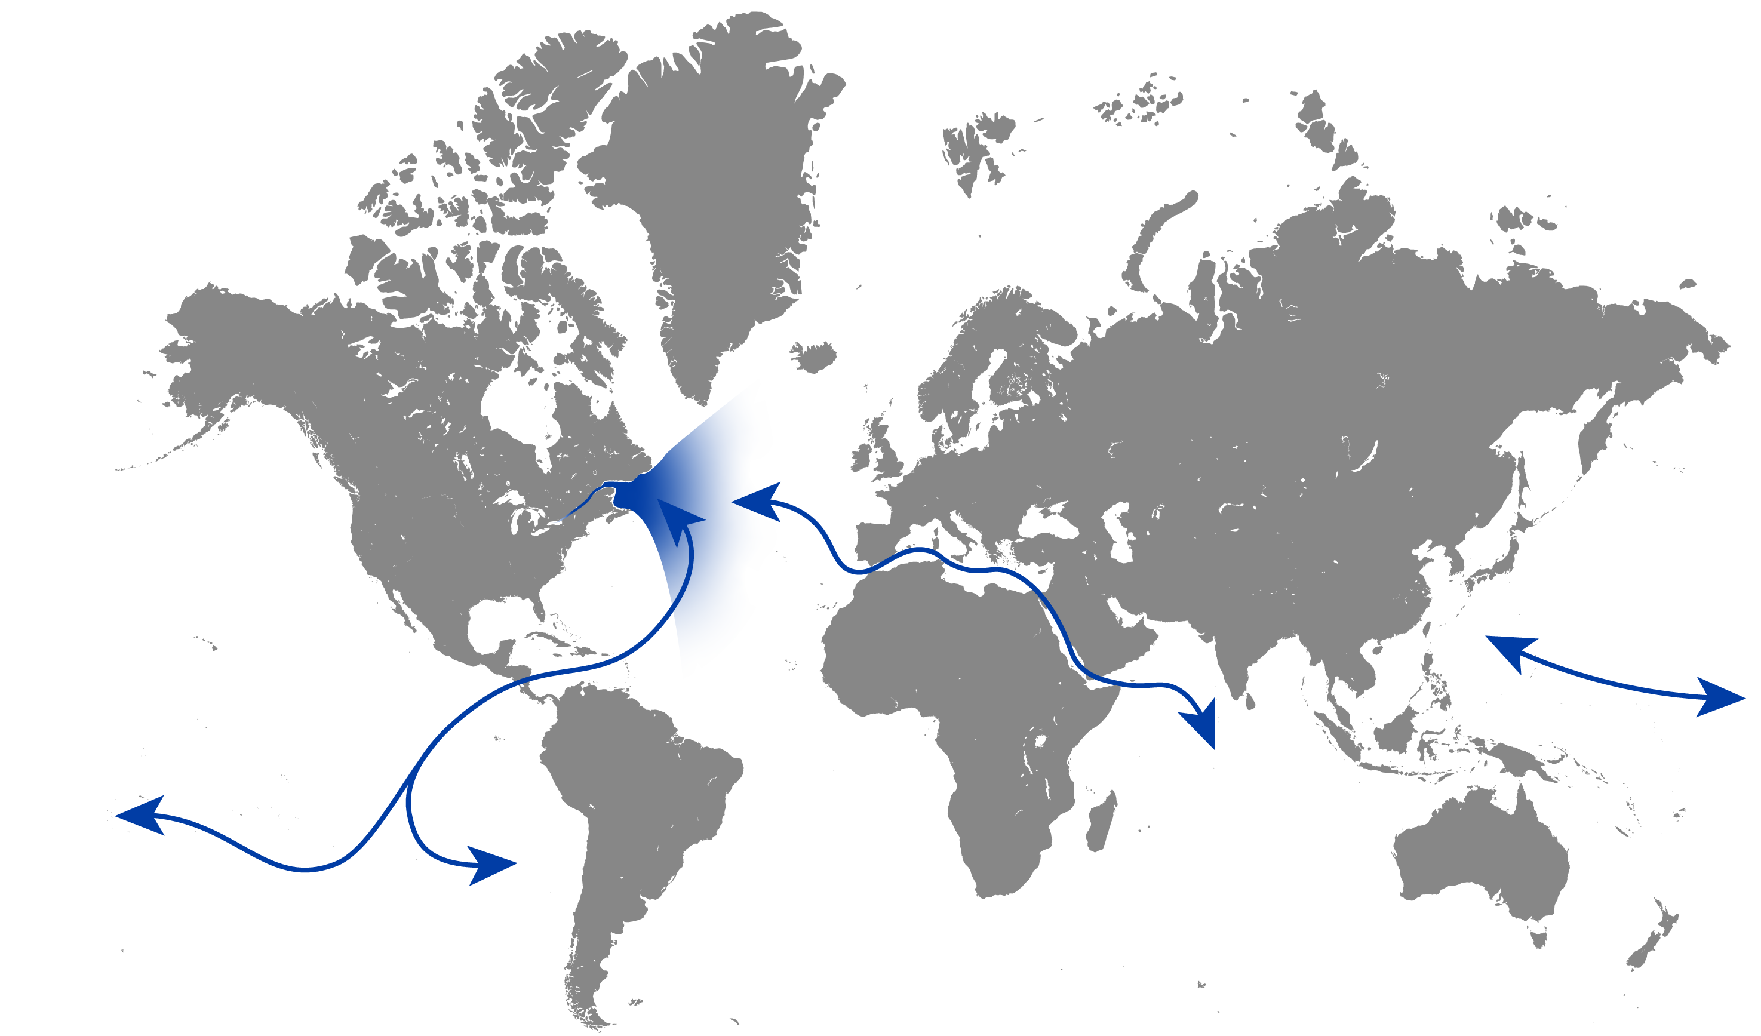
THE ST. LAWRENCE RIVER: A STRATEGIC SHIPPING ROUTE
A prosperous commercial
waterway
Québec boasts a worldclass port network and is a strategic vector for international maritime trade.
The St. Lawrence River is one of the most important economic corridors in North America.
THE
ST. LAWRENCE
RIVER
EUROPE
ASIA
NORTH
AMERICA
AFRICA
SOUTH
AMERICA

Slide 6
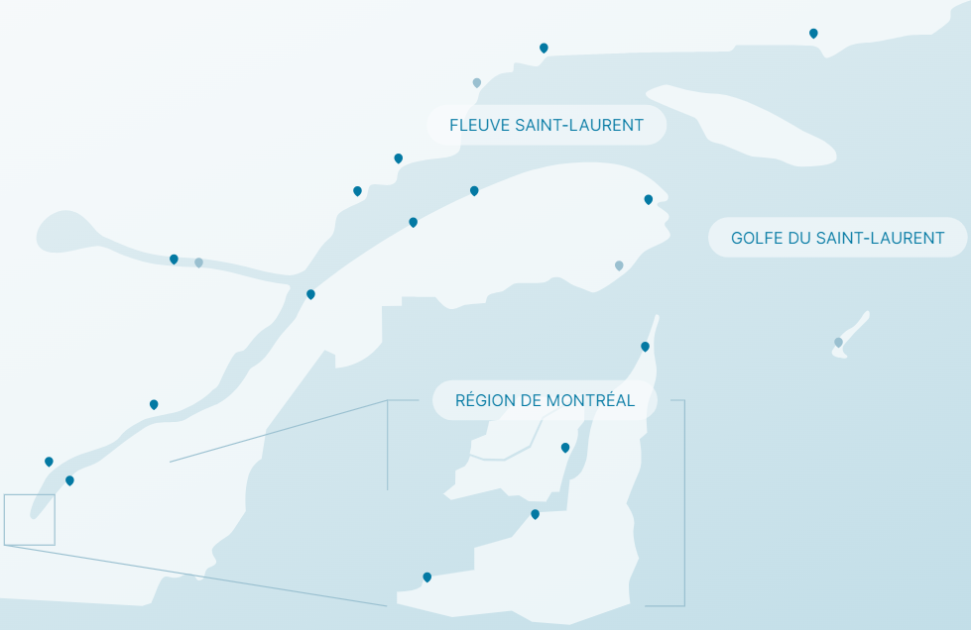



QUÉBEC’S STRATEGIC COMMERCIAL PORT NETWORK
Sept-Îles
Havre-Saint-Pierre
Port-Cartier
Sept-Îles
Port-Cartier
Baie-Comeau
Forestville
Matane
Gaspé
Baie-Comeau
Rimouski
Gaspé
Saguenay
Port-Alfred
Matane
Port-Daniel
Gros-Cacouna
Saguenay
20
commercial ports
Gros-Cacouna
Sorel-Tracy
Cap-aux-Meules
Québec
Québec
Trois-Rivières
Montréal
Trois-Rivières
Bécancour
Bécancour
Côte-Sainte-Catherine
9,700
ship movements
per year
Montréal
Salaberry-de-Valleyfield

Slide 7




THE STRENGTHS OF THE QUÉBEC MARITIME INDUSTRY
Strategic geographic location
Connected intermodal network
Competitive commercial corridors
Dynamic economic driver
Potential for major economic spinoffs
A dynamic, competitive and thriving sector
A robust, diversified ecosystem
A vast network of R&D+i organizations
A highly skilled workforce
The St. Lawrence River, a protected, natural treasure
Sustainable maritime industry
Blue economy development

Slide 8



A GREEN AND INNOVATIVE PORT SECTOR Turnkey solutions and expertise
OPTIMIZATION AND LOGISTICS​​
R&D HUBS AND ORGANIZATIONS
CLEANTECH
Clean energy
Natural resources
Smart, electric vehicles
Environmental technologies
GHG reduction and decarbonization
Water recovery and management technologies
Instrumentation and control systems
Technological integration
Logistics optimization
Smart, inter-modal transportation
Improved maritime safety
AI for tracking, tracing and information management
Innovations in optimization and logistics technology
Port and maritime technologies
Maritime shipping and transport
Maritime engineering
Underwater and hyperbaric operations
The largest maritime training center in Canada
A large community of researchers and scientists
Various R&D initiatives
Collaborative research
Participation in international and multilateral initiatives

Slide 9



















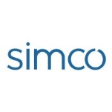
































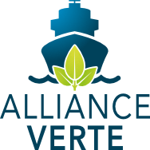






THE QUÉBEC PORT INDUSTRY:
Solutions and organizations
Cleantech
Optimization and logistics
R&D hubs and organizations

Slide 10
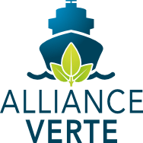



THE QUÉBEC PORT INDUSTRY: A few cutting-edge projects
SYSTEM FOR MANAGING AND SHARING DATA BETWEEN MARITIME ORGANIZATIONS
The aim of this SODES-led project is to provide users of the St. Lawrence with a common framework to standardize and exchange data, using an innovative model to enhance competitiveness, efficiency, and flow in the maritime and logistics sector.
THE LIGHTHOUSE
Innovation laboratory that gives the business community access to the Port of Québec’s infrastructure, opportunities, expertise, and network.
GREEN MARINE INTERNATIONAL
The Green Alliance is an ambitious environmental certification program for the international maritime industry. It seeks to reduce the industry's environmental footprint by engaging stakeholders in a continuous improvement process.
Notes:
You may show videos of these initiatives during the presentation. Click on the name of the project on the slide to access the link.
The Lighthouse video: https://youtu.be/e1D6UrPIaOE
Green Marine International video: https://youtu.be/WCy28kqAGho?si=FJV1hll28Sl3HLMG
The Lighthouse website: https://innovation.portquebec.ca/en/
Green Marine International website: https://green-marine.org/

Slide 11
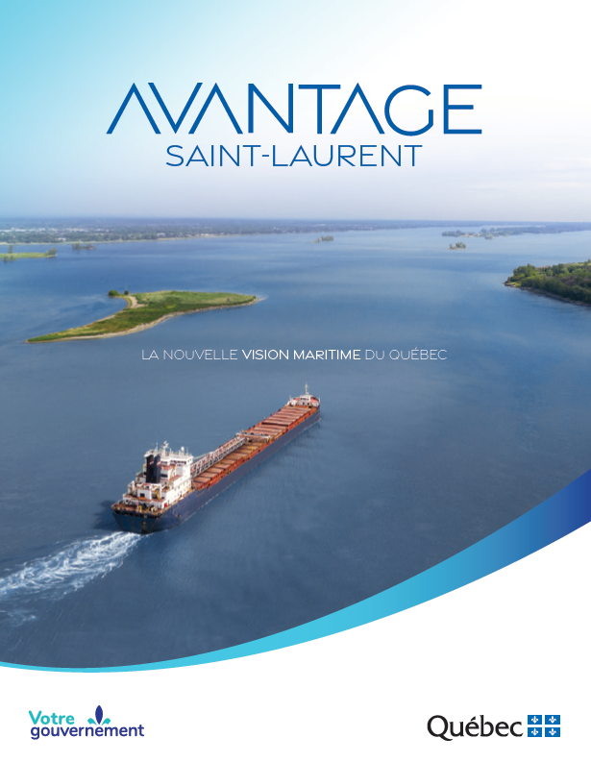
ADVANTAGE ST. LAWRENCE: Québec’s maritime vision
Québec is committed to making the St. Lawrence River a thriving economic corridor while respecting marine and riverside ecosystems and communities through the implementation of ADVANTAGE ST. LAWRENCE, Québec’s maritime vision.
- Government of Québec, ministère des Transports et de la Mobilité Durable, June 2021

Slide 12
ADVANTAGE ST. LAWRENCE Priorities and projects
Priorities
Total : CA$926.9M
1
2
3
Equip the St. Lawrence River with modern, competitive port infrastructures.
→ CA$300M
Ensure efficient, environmentally friendly navigation on the St. Lawrence River.
→ CA$57.6M
Offer riverside communities promising sustainable development opportunities.
→ CA$394.3M
A few examples
1
2
3
4
Establish a smart economic corridor.
→ CA$24.1M
Develop industrial port sites and logistics hubs.
→ CA$166.3M
Mitigate the impact of shipping on ecosystems.
→ CA$5.0M
Implement a new marine infrastructure investment program.
→ CA$100.0M

Slide 13
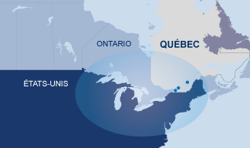




MONTRÉAL PORT AUTHORITY – Contrecœur Port Terminal Expansion Project
1.15 million additional 20-foot containers (60% increase)
Intermodal railway yard connected to the road network
GHG emission reduction (the use of electrical port equipment and wharf electrification)
Serves
Québec/Ontario/Midwest
Economic spin-offs estimated at over CA$140M per year
Environmental measures put in place to protect species at risk of extinction
Financial participation from the governments of Québec and Canada and the Canada Infrastructure Bank
Scheduled to open in 2027
Source: Montréal Port Authority, Contrecœur Terminal Expansion Project

Slide 14
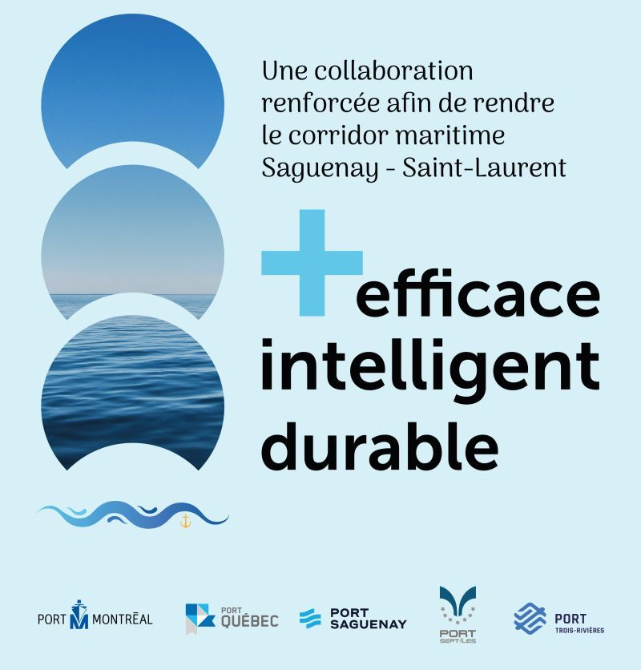
SAGUENAY—ST. LAWRENCE MARITIME CORRIDOR Montréal • Québec • Trois-Rivières • Saguenay • Sept-Îles
Extending the collaboration that started in 2022
Improving performance, resilience, and efficiency
Creating joint working committees
Focuses:
Environmental innovation (decarbonization)
Supply chain optimization and resilience
Asset management
Maritime operations
Communications and relations with neighbouring communities

Slide 15

Thank you
Québec.ca/international
For more information, we invite you to consult our Cap Saint-Laurent showcase
Notes:
Link to Cap Saint-Laurent: https://capsaintlaurent.com/en/

