Slide 1

Québec Successful
Huge mineral potential to decarbonize the economy and contribute to the energy transition
> EXPLORE THE POSSIBILITIES

Slide 2












Why choose Québec’s mining sector?
Funding at every stage of the project
A variety of mineral resources
A free public database
Clean, renewable energy
An extensive infrastructure network
Cutting-edge expertise and a skilled workforce
An advantageous tax system
All minerals needed for batteries
A comprehensive, well-developed mining ecosystem
A sustainable, responsible partner
A stable, predictable legal framework
Partnerships with Indigenous nations

Slide 3
What sets us apart:
an investment-friendly business environment
Québec is politically stable.
In the mining sector, all stakeholders and partners collaborate closely, and the Government of Québec actively supports developers and companies through public corporations and their divisions and subsidiaries.
Mining investment ranks among the best in the world.
According to the Fraser Institute’s 2022 survey, Québec is the 8th most attractive mining jurisdiction in the world.
Notes:
Québec offers foreign companies a business climate that is highly conducive to mining investment and innovation, as well as a tax system that compares favourably with that of its trading partners.
Roles of key government players:
Ministère des Ressources naturelles et des Forêts
Develops government policies and programs in the mining sector
Establishes the legal and regulatory framework for mining activities
Investissement Québec
Is a public corporation whose mission is to play an active role in Québec’s economic development by stimulating business innovation, entrepreneurship, and takeovers, as well as investment and export growth
Acts as a hub for foreign investors, with over 1,200 experts spread over more than 30 offices in 19 countries and 6 Canadian cities
SOQUEM (subsidiary of Investissement Québec)
Aims to promote the exploration, discovery, and development of Québec’s mineral resources
Has participated in and contributed to the launch of hundreds of projects that have led to major discoveries of gold, diamonds, lithium, niobium, rare earth elements, and many other mineral substances
Société du Plan Nord
Is a public corporation whose mission is to contribute to the integrated and concerted development of Québec’s northern territory, in collaboration with the private sector and representatives of the regions and Indigenous nations involved
Facilitates the search for and deployment of solutions that suit the specific characteristics of the region, which has rich mineral potential
Société de développement de la Baie-James
Participates in economic development and managing road and airport infrastructure, facilitating and supporting business projects in the region
Supports the economic development of the James Bay region through investments in profitable, capacity-building business projects in various economic sectors

Slide 4
What sets us apart: an advantageous tax system
Overall, Québec’s tax system is competitive due to its corporate tax rates, taxable income calculation rules, and the many tax credits and tax holidays available to companies.
Québec has advantageous tax measures to support companies at every stage of the mining cycle.
Notes:
Overall, Québec’s tax system is competitive due to its corporate tax rates, taxable income calculation rules, and the many tax credits and tax holidays available to companies.
It is difficult to compare tax systems from one country to next because of the many differences that can exist between them. This is why we cannot conclude that one system is superior to another simply by looking at the corporate tax rate. In short, business leaders need to assess a country’s tax system based on their own situation and consider the taxable income calculation rules, tax rates, payroll and consumption taxes, and different tax measures in force.
Find out more about the advantages for investors (affordable labour costs, reasonably priced leases, and one of the most competitive tax rates in North America) and how Québec has everything companies need to compete on the world stage on this page: Competitive operating costs (https://www.investquebec.com/international/en/why-quebec/operating-costs.html)
Mining companies are also subject to mining tax, and must pay either the minimum mining tax or the mining tax on annual profit, whichever is higher. For more information on the subject, please refer to “Le régime d’impôt minier en bref”. (https://cdn-contenu.quebec.ca/cdn-contenu/adm/min/finances/publications-adm/Autres_documents/AUTFR_RegimeImpotMinierEnBref.pdf) An older English version of the document, The Mining Tax Regime in Brief, is available here:
https://www.finances.gouv.qc.ca/documents/Autres/en/AUTEN_MiningTaxRegimeInBrief.pdf.
Québec offers refundable tax credits, deductions, and allowances which, cumulatively, make it a very attractive business environment.

Slide 5
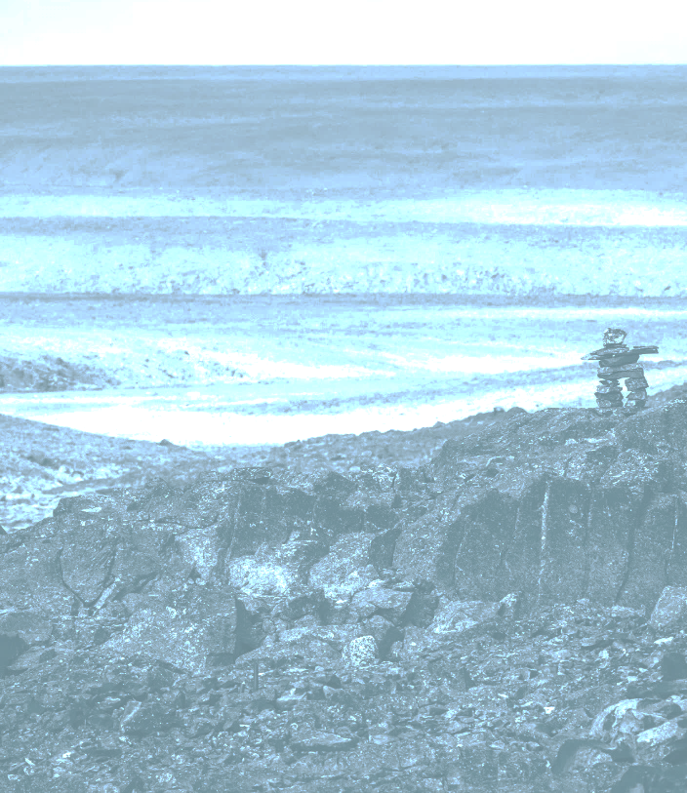
What sets us apart: leadership in responsible and sustainable development
Renowned social acceptability practices
Partnerships with Indigenous nations:
James Bay and Northern Quebec Agreement
Northeastern Quebec Agreement
Aboriginal Community Consultation Policy Specific to the Mining Sector
Notes:
Social acceptability and sustainable development are paramount in Québec; they are foundational principles for land use.
In Québec, social acceptability is one of the most important factors for the development and implementation of natural resource projects.
Communication and transparency are deeply rooted Québec business practices that help make projects successful, benefitting both host communities and promoters.
Québec is fortunate to have a large Indigenous population with whom it has been able to establish modern treaties and lasting partnerships. The James Bay and Northern Québec Agreement, signed in 1975 between the Government of Québec, the Cree Nation, and the Inuit of Northern Québec, is one such treaty. This agreement was intended to promote the economic and social development of Northern Québec.
La Grande Alliance, signed in 2020, is another agreement between the Government of Québec and the Cree Nation to plan and execute a 30-year infrastructure program. It aims to facilitate the transportation of people and goods and increase the value of natural resources by reducing transportation costs, all while developing and protecting the Eeyou Istchee-James Bay region.
The Native Community Consultation Policy Specific to the Mining Sector, which has been public since 2019, promotes, among other things, better consideration of the concerns expressed by Indigenous communities with regard to mining activities. It also provides guidelines for the mining sector for the consultation process with those communities.

Slide 6
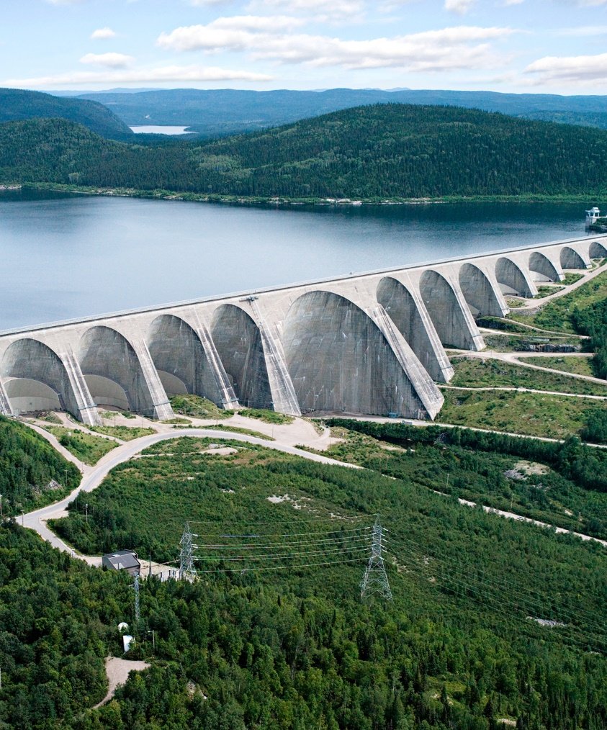
What sets us apart: clean, renewable energy
Québec is one of the world’s top 5 producers of hydroelectricity.
99% of the electricity generated in Québec comes from clean, reliable, and renewable energy sources.
Hydro-Québec is part of the solution to reduce GHG emissions.
Notes:
– Québec is one of the top 5 producers of hydroelectricity in the world and supplies 52% of Canada’s hydroelectricity.
– 99% of the electricity generated in Québec comes from clean, reliable, and renewable energy sources.
– Hydro-Québec, a public corporation, is an essential asset in the fight against climate change. Its large generation fleet has an installed capacity of 37,436 megawatts (MW) as of December 31, 2023.
– Hydro-Québec is also a unique research and development hub. In addition to supporting all of its activities, from electricity generation to consumption, Hydro-Québec’s research focuses on battery materials. The public corporation has obtained some 100 families of patents, licensed around 60 technologies, and published approximately 250 scientific papers. This work is being carried out at the Institut de recherche en électricité du Québec (IREQ) and the Center of Excellence in Transportation Electrification and Energy Storage. Hydro-Québec’s Center of Excellence in Transportation Electrification and Energy Storage is a world-class innovation hub in the field of battery materials for electric vehicles and other energy storage applications, both stationary and mobile.

Slide 7
What sets us apart: renowned scientific expertise
Mining in Québec relies on the optimization and development of new metallurgical processes as well as the expertise of numerous applied research centres, research networks, and assistance and support for businesses:
Corem
Elements08 Strategic Metals Excellence Centre
Agora 49 Consortium
Metal Transformation Research and Innovation Consortium (CRITM)
CSM Scientific Network
Notes:
Mining in Québec relies on the optimization and development of new metallurgical processes as well as the expertise of numerous applied research centres and research networks, including:
Corem, a partner of successful mining companies in Québec, Canada, and around the world
The Elements08 Strategic Metals Excellence Centre, which focuses on the responsible and sustainable use of strategic metals
The Agora 49 Consortium, a research and innovation network and one of nine sector-based industrial research groups (RSRIs) in Québec, which is dedicated to industrial research
The CRITM, one of nine RSRIs whose mission is to help metal processing companies become more competitive by providing support for innovation
The CSM Scientific Network, whose mission is to encourage collaborative and pre-competitive research to support the development and sustainability of CSM value chains

Slide 8
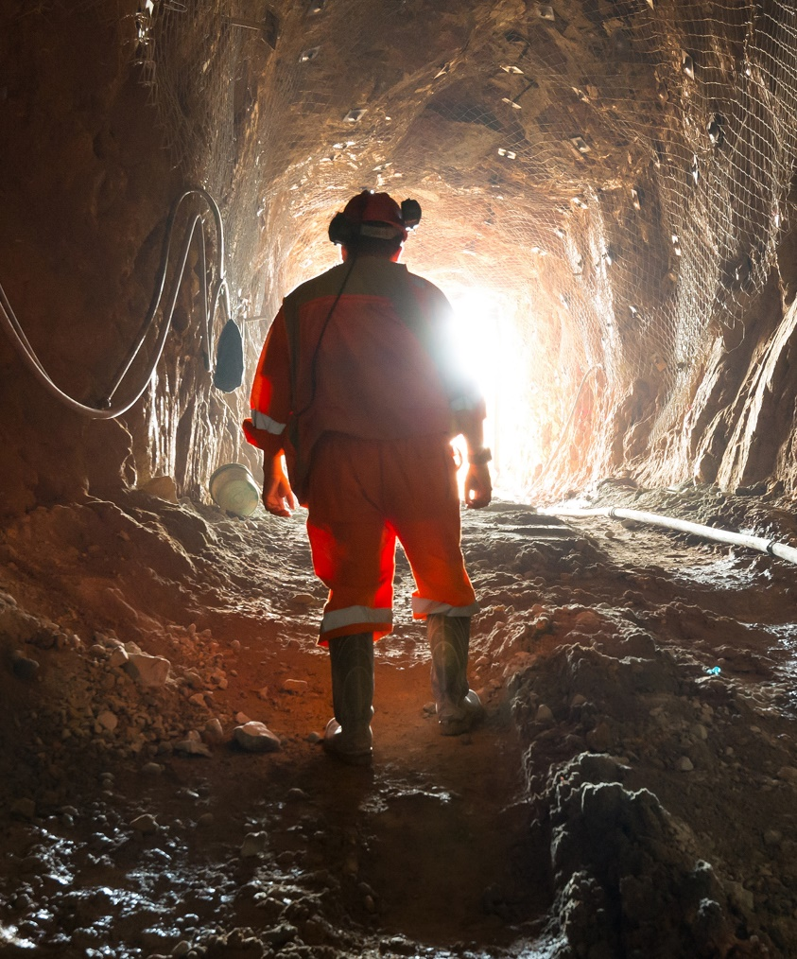
What sets us apart: a skilled workforce
A diverse and complementary network of learning institutions:
renowned universities
colleges
vocational training centres
college technology transfer centres
Training services tailored to companies’ needs and multiple continuing education programs designed to respond to market needs
A comprehensive mechanism to support skills development
Institut national des mines
Notes:
In 2022, the mining industry directly employed over 13,000 people (mineral exploitation).
Global mining players like Tata Steel, Rio Tinto, Glencore, ArcelorMittal, Newmont, and Agnico Eagle are present in Québec.
Québec is internationally renowned for its skilled workforce. It is a long-standing mining producer with experienced workers in every region and specialized suppliers for all phases of the mineral development process. Its mining sector can count on an annual pool of 10,000 new graduates from 50 mining-related training programs.
Québec has specialized college centres for technology transfer: the Centre technologique des résidus industriels, the Québec Metallurgy Center, the National Center in Environmental Technology and Electrochemistry, and the Institut technologique de maintenance industrielle.
We are in the midst of a major technological shift that is influencing the skills needed on the labour market. For that reason, we have a number of tools to support skills development.
The Ministère du Travail, de l’Emploi et de la Solidarité sociale (MTESS) is responsible for labour and employment, making it a key government partner. It may provide grants to businesses so they can partially subsidize training costs, hire human resources management consultants, or partially cover the salaries of people who face certain barriers to employment. It can also provide financial support to allow unemployed people to train for jobs in these companies. The Commission des partenaires du marché du travail has multiple financial support programs for worker training and internships.
The Institut national des mines supports and advises ministers through research reports, pilot projects, and over 120 partners, collaborators, and researchers from the education and mining sectors. The institute also supports educational institutions and companies in the mining industry in the development of innovative, diversified training.

Slide 9
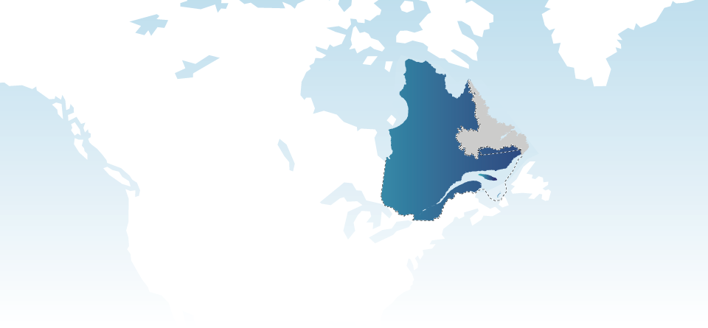
Critical and Strategic Minerals
Huge mineral potential to decarbonize the economy and contribute to the energy transition

Slide 10
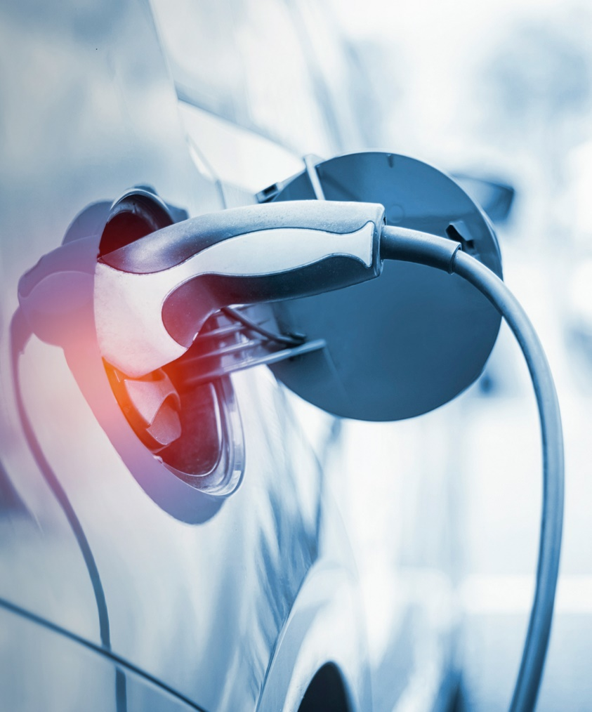
Growth in global demand for critical and strategic minerals (CSMs)
CSMs are indispensable for key sectors of the economy:
aerospace
transportation, batteries, and electric vehicles
high technology
renewable energy
life sciences
Notes:
Global demand for critical and strategic minerals (CSMs) continues to grow. According to a World Bank report published in 2020, the energy transition toward a low-carbon economy will bring a sharp increase in demand for minerals such as nickel, vanadium, indium, cobalt, lithium, and graphite.
CSMs are used for manufacturing in many fields, including aerospace, smart devices and equipment, telecommunications, renewable energy, energy storage, medicine, national security, and transport electrification. These are all growth sectors for which a supply of CSMs is essential.
Critical minerals are defined as minerals that are essential to key sectors of the economy, present a high supply risk, and have no commercially available substitutes. Strategic minerals are mineral substances that are crucial for implementing key policies.

Slide 11
CSM supply: a challenge
Most of the world’s current production comes from China.
Québec’s soil is rich in mineral resources, including 28 CSMs:
Québec’s critical minerals are antimony, bismuth, cadmium, cesium, copper, tin, gallium, indium, tellurium, and zinc.
Québec’s strategic minerals are aluminum, apatite, cobalt, rare earth and platinum group elements, high-purity iron, germanium, graphite, lithium, manganese, magnesium, nickel, niobium, scandium, high-purity silica, tantalum, titanium, and vanadium.
Notes:
The supply of CSMs is a concern, as there is a heavy dependency on production that is dominated by China.
Québec’s soil is rich in mineral resources that are either being mined or have the potential to be mined. This is why Québec is keeping a close eye on global demand for the minerals needed for the energy transition, particularly over the next few decades.
The Ministère des Ressources naturelles et des Forêts (MRNF) participated in preparatory work for the list of Canada’s critical minerals, which made it possible to consider the critical and strategic minerals recognized by Québec. Of the 31 minerals deemed critical and strategic by the federal government, the vast majority are on the list that was updated in January 2024, paying testament to Québec’s great potential and diverse geology.

Slide 12
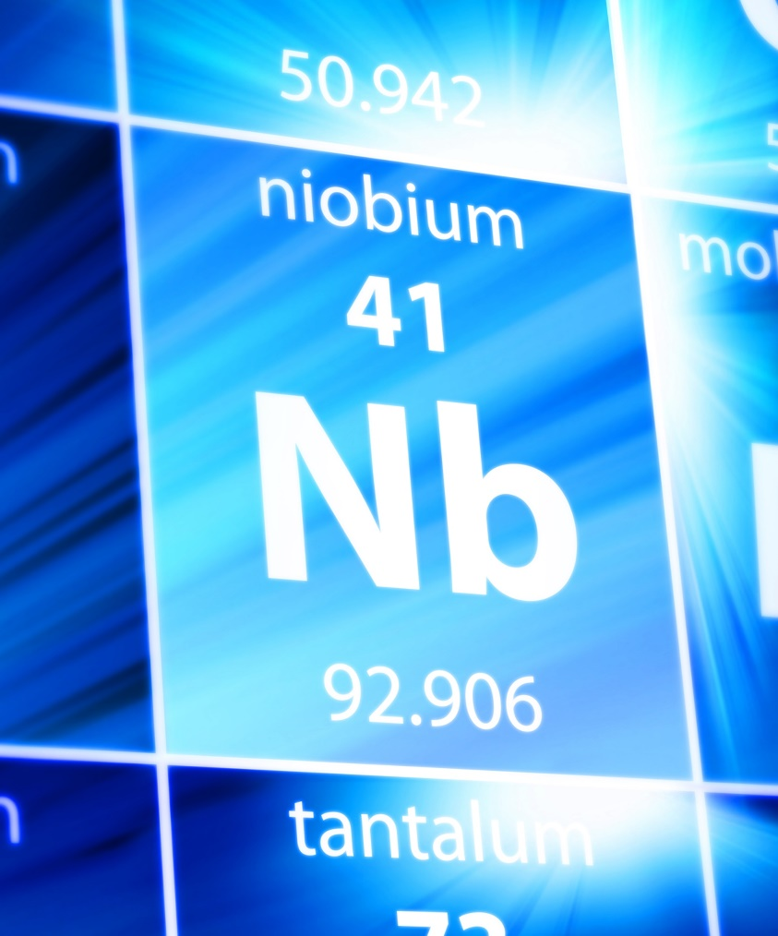
Québec: a key CSM producer
Québec produces the most diverse range of minerals in Canada.
It has 20 active mines, 5 of which produce the most in-demand CSMs in the United States: cobalt, platinum-group elements, graphite, niobium, and titanium.
It produces aluminum and has restarted lithium production.
Québec is the world’s second-largest producer of niobium.
Notes:
One fifth of Canada’s mining production comes from Québec. The resources exploited here are the most diversified in Canada: 15 metals and 13 minerals are produced and recovered, including lithium, rare earth minerals, and apatite.
Mine shipments were valued at $10.6 billion in 2023, an increase of more than 12% over 2022.
Exploration and development spending on CSMs has skyrocketed since 2020:
2020: $61M
2021: $194M
2022: $319M
2023 (preliminary data): $447.9M
Québec is one of the world’s few producers of niobium, titanium dioxide, cobalt, and platinum.
Québec currently produces nearly 20% of the world’s scandium oxide. It has deposits of other rare earth elements, including vanadium. One of the largest graphite mines in the Western world (owned by Nouveau Monde Graphite) will be located in Québec, in Lanaudière. The Government of Québec approved the project in February 2021. The mine will eventually be 100% electric.
With the restart of the North American Lithium project, Québec is the only lithium producer in Canada.
Québec is Canada’s leading aluminum producer.
Québec is one of the few producers of niobium and ranks second in global production. Niobium is a rare metal used in situations where corrosion resistance is important, as well as in high-pressure boilers, superalloy nozzles, and space capsules. A single mine in Saint-Honoré, Québec, accounts for 15% of global production.
Québec is the second-largest producer of nickel in Canada and the fifth-largest producer of copper and zinc. It is also Canada’s leading producer of iron and zinc concentrate and second-largest gold producer, as well as owning Canada’s only active copper smelter.

Slide 13
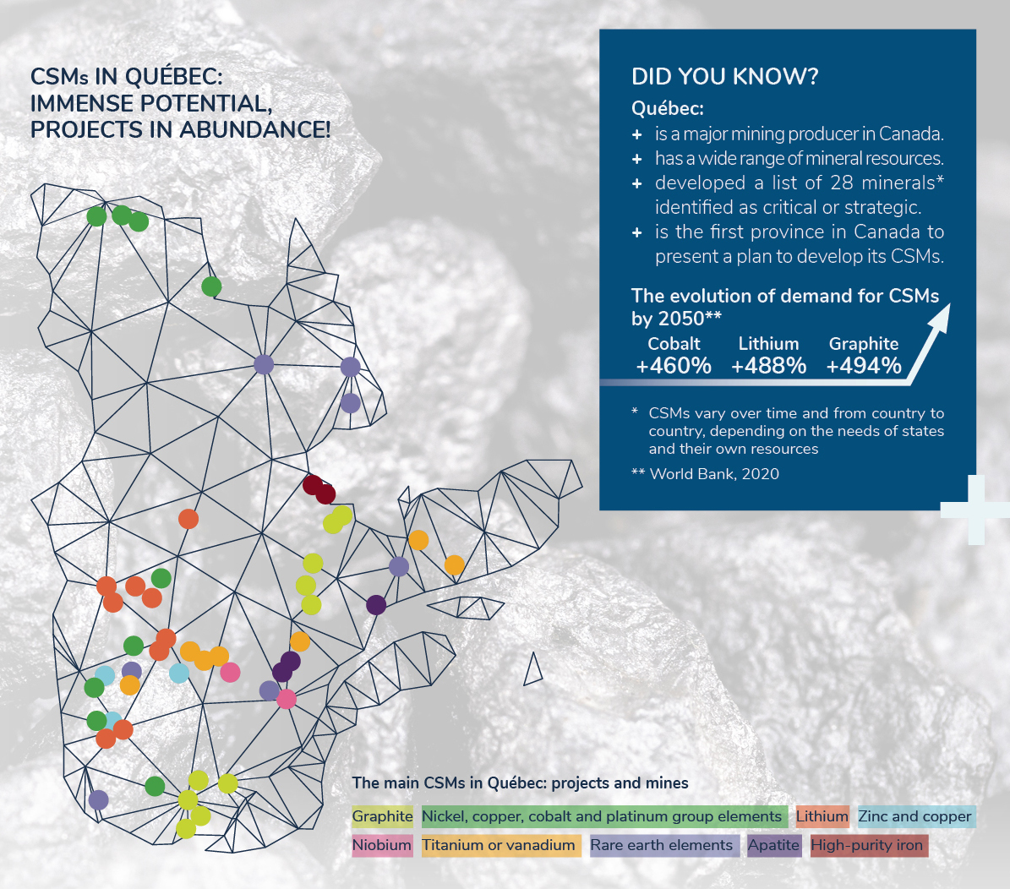
CSMs in Québec: huge potential, plenty of projects. Source: FS_PQVMCS.pdf (quebec.ca)

Slide 14
Québec’s international objectives regarding CSMs
The main objective is to generate investment and establish strategic partnerships to develop CSM sectors.
The Investing in Québec’s Mining Sector brochure for investors is available online in French and English.
Notes:
Governments play a key role in orienting their industries toward CSM supply sources, and in setting up institutional funds dedicated to CSMs.
The current situation shows that Québec is focused on primary processing (mining), but in the long term it also wants to develop secondary processing (transformation of ores into alloys or parts) and tertiary processing (manufacture of parts and equipment, such as batteries for electric cars).
In addition, Québec is focusing on the processing and recycling of critical and strategic minerals as a means of developing a circular economy.

Slide 15

Québec’s international objectives regarding CSMs
More broadly, the network of Québec government offices abroad can:
help position Québec as a key global player in CSMs in the medium and long term
support MRNF promotional activities and Investissement Québec International canvassers

Slide 16
Promoting Québec’s CSM potential
The Québec Plan for the Development of Critical and Strategic Minerals 2020–2025 includes an accelerating investment of over $100 million to:
Acquire geoscientific knowledge
Coordinate R&D stakeholders to increase synergy and innovation, with a particular focus on circular economy principles
Consolidate multi-user transportation, energy, and telecommunications infrastructure networks
Financially support innovative projects in exploration, transformation, recycling, artificial intelligence, and R&D
Stimulate investment in Québec and support businesses in their development projects
Act in synergy with other Québec policies: Plan for a Green Economy, Québec’s Battery Industry Development Strategy, 2020–2023 Northern Action Plan
Notes:
This plan stems from the government’s desire to support the transition to a greener economy and help Québec’s regions prosper. It will allow for the establishment of CSM value chains in Québec while following sustainable development and social acceptability principles, as well as principles for creating wealth throughout Québec, including in local and Indigenous communities.
The Plan considers the high environmental protection and worker health and safety standards that are already in place.
The Plan for a Green Economy will help Québec achieve its 2030 target for greenhouse gas emission reductions (a 37.5% reduction from 1990 levels), as well as carbon neutrality by 2050.
The Northern Action Plan is an exemplary sustainable development project. The Government of Québec and its partners will invest more than $1.4 billion in the sustainable development of Northern Québec (north of the 49th parallel) over the next three years. This government strategy aims to achieve tangible results for northern communities. It factors in energy, mining, forestry, bio-food, tourism, and road development while promoting wildlife enhancement, environmental protection, and biodiversity conservation.
The Government of Québec is also banking on the development of Québec’s battery industry over the next few years (see next slide).

Slide 17
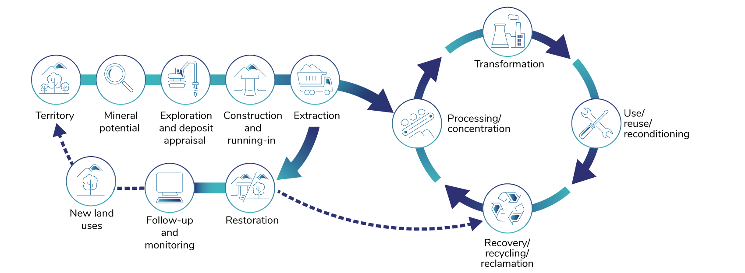
Reducing the environmental footprint with a circular economy
Source: Québec Ministère de l’Énergie et des Ressources naturelles.
Notes:
Since these minerals are not renewable, it is important to develop strategies to optimize the use of available resources, particularly by putting materials back into circulation. The circular economy, a key pillar of the Québec Plan for the Development of Critical and Strategic Minerals 2020–2025, relies on “green” design and the recycling and reuse of mineral resources. This forward-looking approach will reduce our environmental footprint and meet the demand for CSMs. The recovery and recycling of critical and strategic minerals will be encouraged. The goal is to reuse or recycle tailings or goods components, giving them a second life.
Two calls for proposals have been launched as part of the QPDCSM-funded Research and Development Support Program for the Circular Economy Applied to Critical and Strategic Minerals (CSM) Value Chains.
In Québec, some projects or studies related to the recycling of critical and strategic minerals have already received financial support from the Québec government. Two examples: the Lion project, which is developing a technology for recycling lithium-ion batteries, and the Géoméga rare earth recycling plant for the magnet industry.

Slide 18
Development of the battery industry and expertise in electric transport
Responsibly and sustainably mine and process minerals from Québec to manufacture battery components
Produce electric commercial vehicles
Develop battery recycling
Canada and the United States see themselves as strategic partners in the development of CSMs—particularly for the electric vehicle sector—and Québec is in an excellent position to play a leading role in that partnership.
Notes:
The Québec Battery Initiative focuses on the rapid development of a world-class production chain in Québec, from the extraction of ores to the development of “green” processes and the production of finished components.
The initiative has three components:
Responsibly and sustainably mine and process minerals from Québec to manufacture battery components like anodes and cathodes.
Produce electric commercial vehicles. Objective: invest in the local manufacture of electric vehicles.
Develop battery recycling using cutting-edge technologies from Québec.
To date (2023), the main announced battery projects have an estimated value of nearly $11 billion. Of this amount, $5.9 billion, or 54% of the total value of the projects, will be invested by private companies setting up in Québec.
Québec is ready to accelerate the development of mining and refining capacity for active battery materials, and to attract world-class companies specializing in the manufacture of battery components. It offers regulatory, tax, and financial incentives to promote the development of the industry. It also provides logistical and competitive initiatives to make Québec batteries greener, recyclable, and distinctive on world markets.

Slide 19
Critical and strategic minerals
Huge mineral potential to decarbonize the economy and contribute to the energy transition

Slide 20


Thank you
> EXPLORE THE POSSIBILITIES
Québec.ca/international

